Slide 1

Analytical Innovators
BUSINESS INTELLIGENCE (BI) – DECISION SUPPORT SYSTEMS (DSS)
Michael Fetick - 84270
Yuxuan Guan - 660161473
Gabriel Ramirez - 52020
Sean Wu - 660161992
Online
Food Ordering
System
SUBWAY® is a registered trademark of
© Doctor's Associates Inc. All Rights Reserved.
Notes:
We are a business consulting company named “Analytical Innovators.”
Subway came to us for expertise in the development of a performance management system to support decisions to resolve difficulties and pursue opportunities. The challenge is to integrate Subway’s new customer online ordering service into their existing restaurant operations.
We developed a balanced scorecard (BSC) that views the Subway Corporation from four perspectives – customer, financial, internal business processes, learning and growth.
The BSC will be used to develop objectives relative to each perspective. KPIs are determined to answer strategic questions for solutions to problems and opportunities.

Slide 2
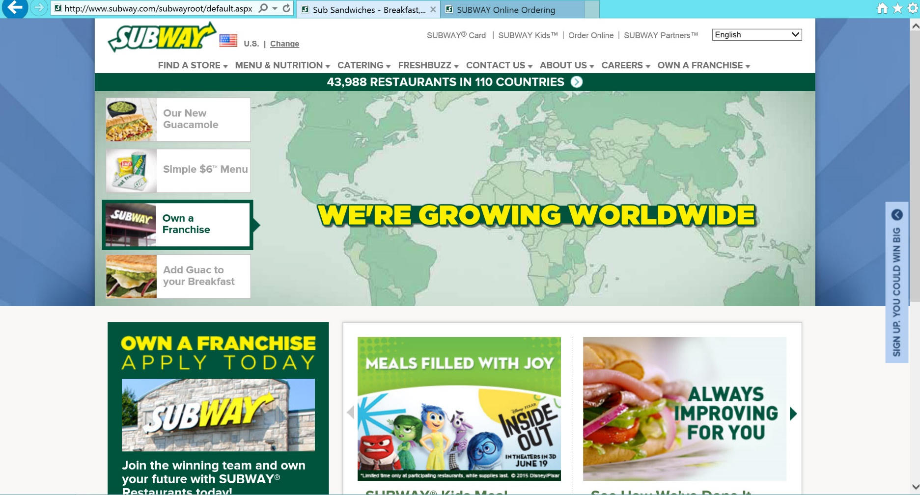

Notes:
This is SUBWAY’s website home page.
Subway is a fast food restaurant that prides itself on offering a healthy food menu.
Notice the link to Order Online. Yes it is small.
SUBWAY knows this service is not a main attraction and it hasn’t yet caught on. But tech-savvy customers will find it because it is a website menu item (pun).

Slide 3
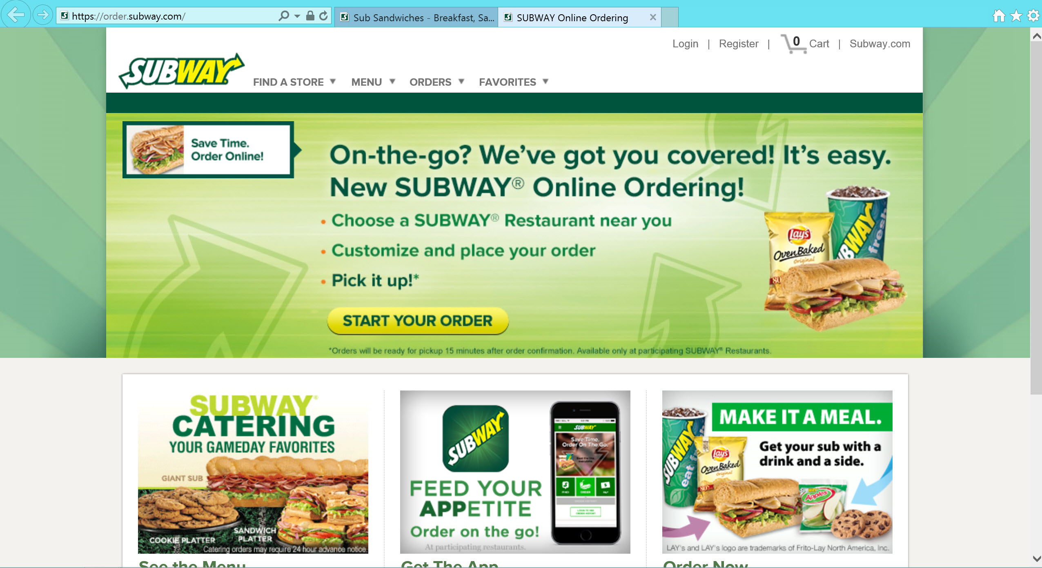
Notes:
SUBWAY’s online order page.
They sum it up “On-the-go?”
A customer can order a meal online and pickup the food on the way to someplace.
The focus is the button to START YOUR ORDER.
Of course the customer can get help with the process like find a store, see the menu, check the order, and save favorites to reuse another time.

Slide 4
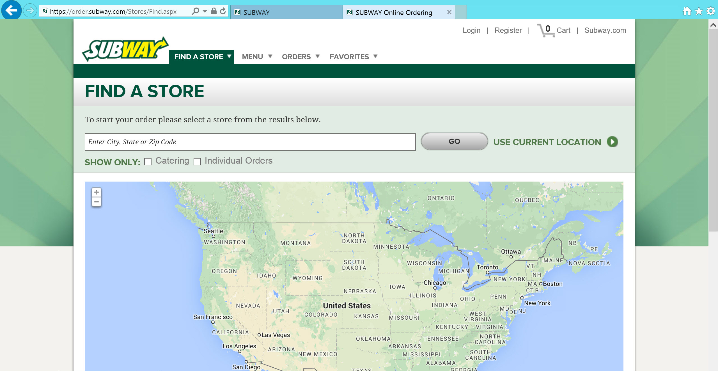
Notes:
This is SUBWAY’s website home page.
Subway is a fast food restaurant that prides itself on offering a healthy food menu.
Notice the link to Order Online. Yes it is small.
SUBWAY knows this service is not a main attraction and it hasn’t yet caught on. But tech-savvy customers will find it because it is a website menu item (pun).

Slide 5
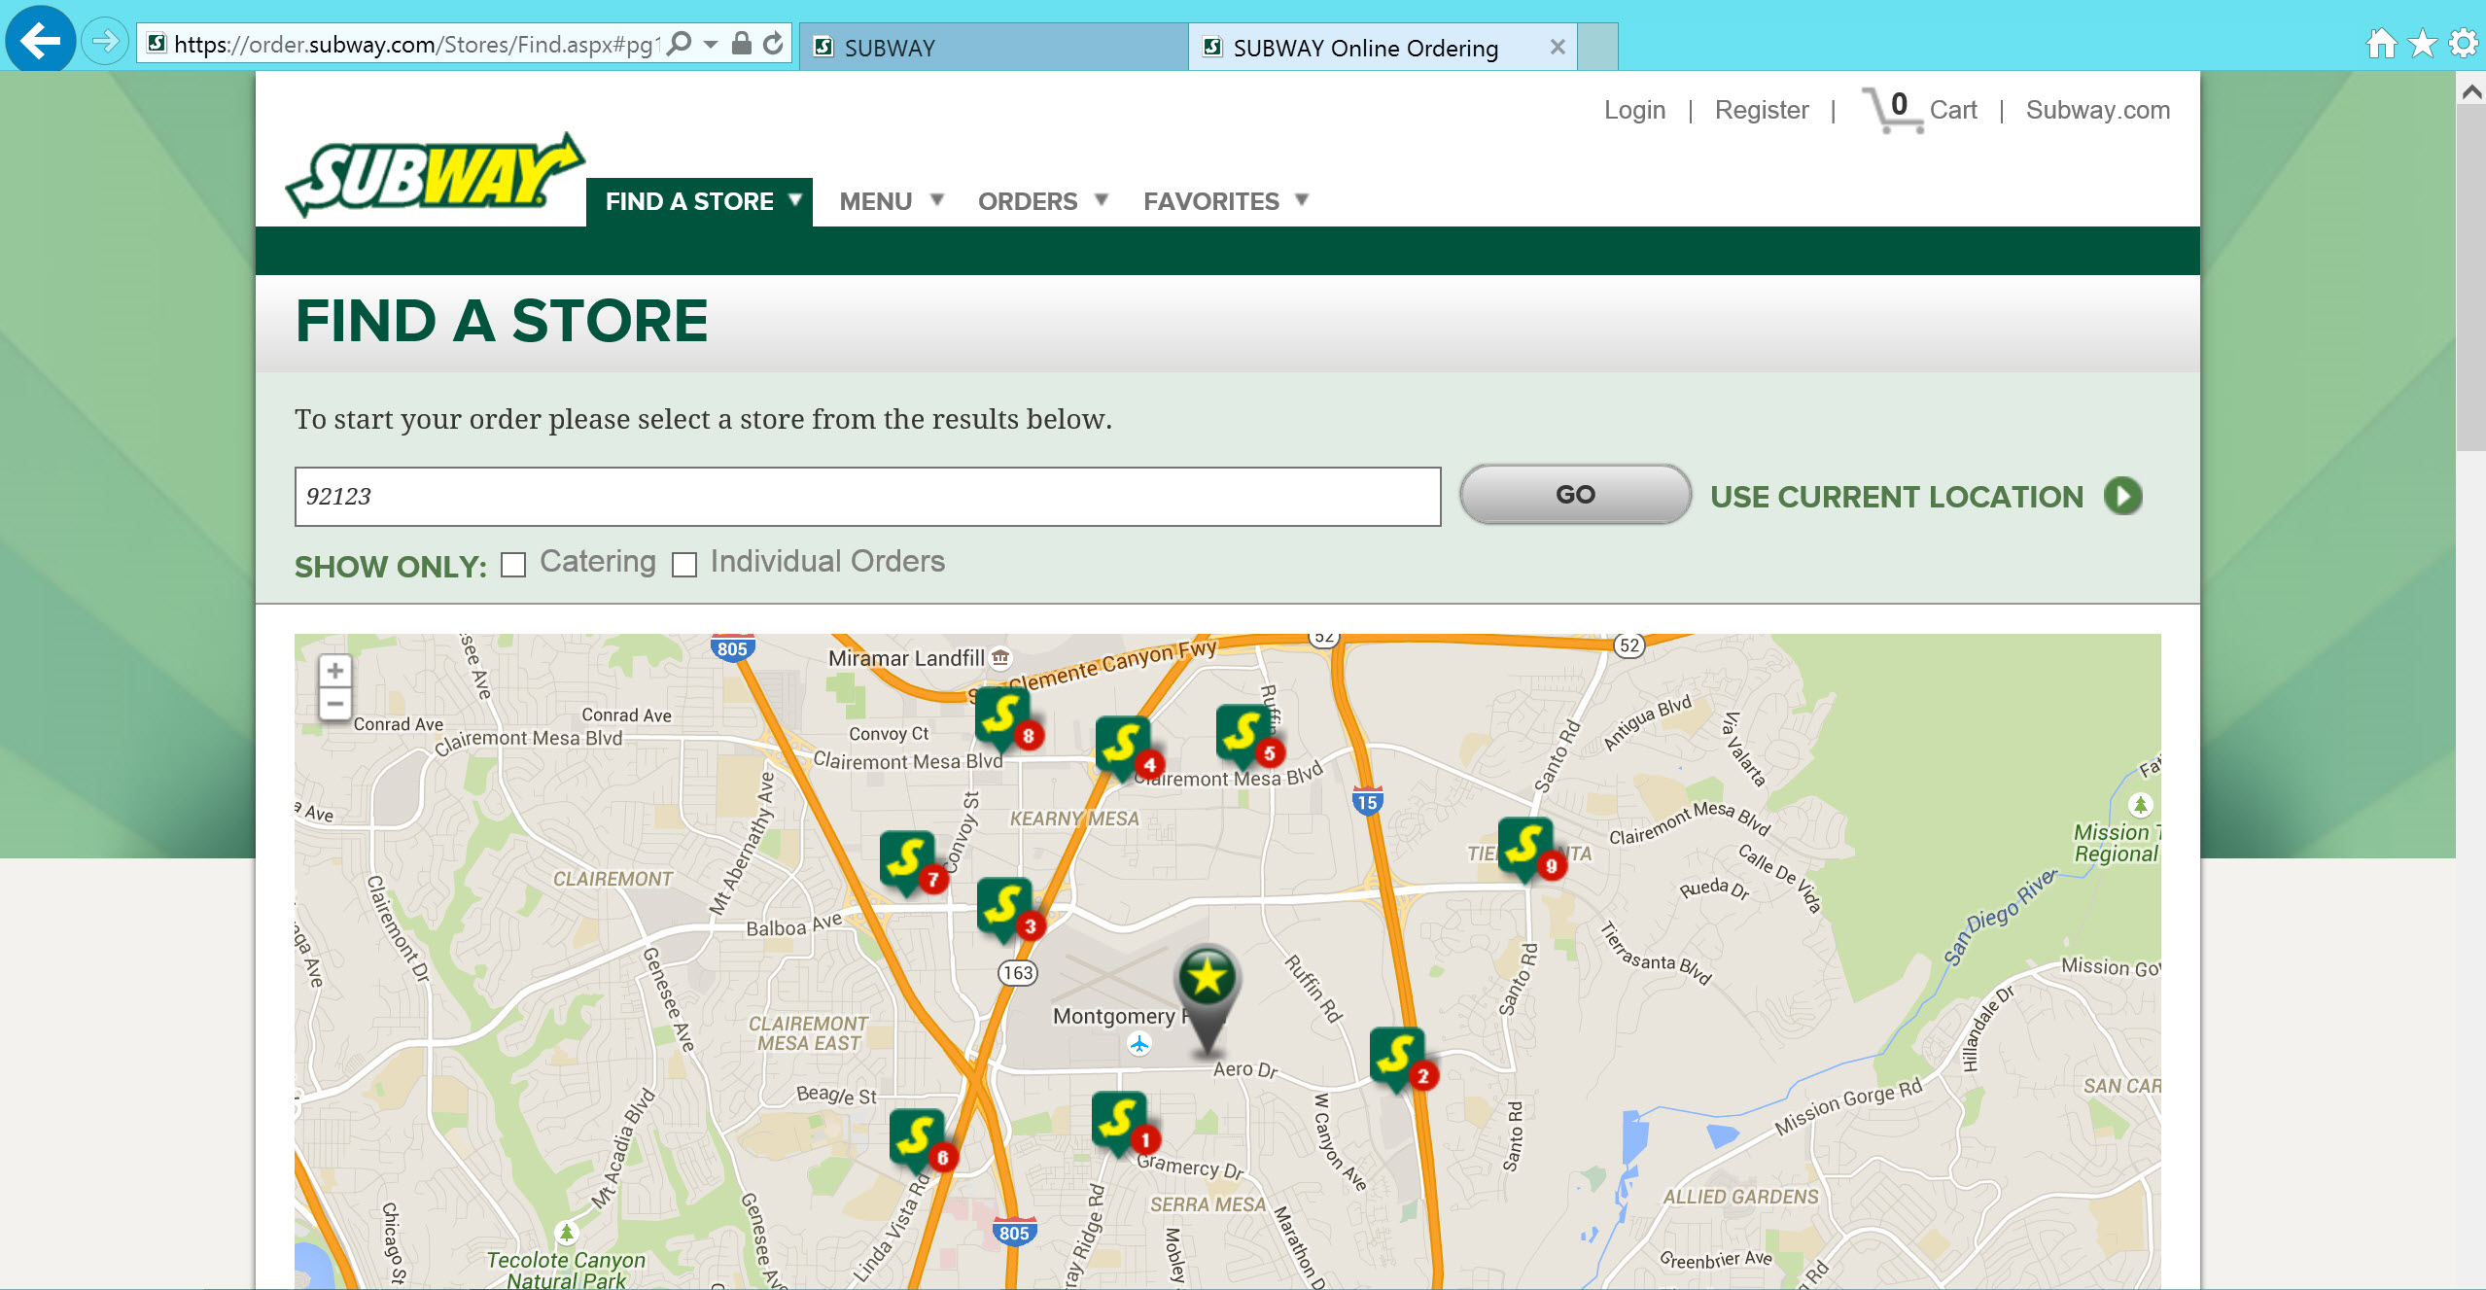
Notes:
This is SUBWAY’s website home page.
Subway is a fast food restaurant that prides itself on offering a healthy food menu.
Notice the link to Order Online. Yes it is small.
SUBWAY knows this service is not a main attraction and it hasn’t yet caught on. But tech-savvy customers will find it because it is a website menu item (pun).

Slide 6
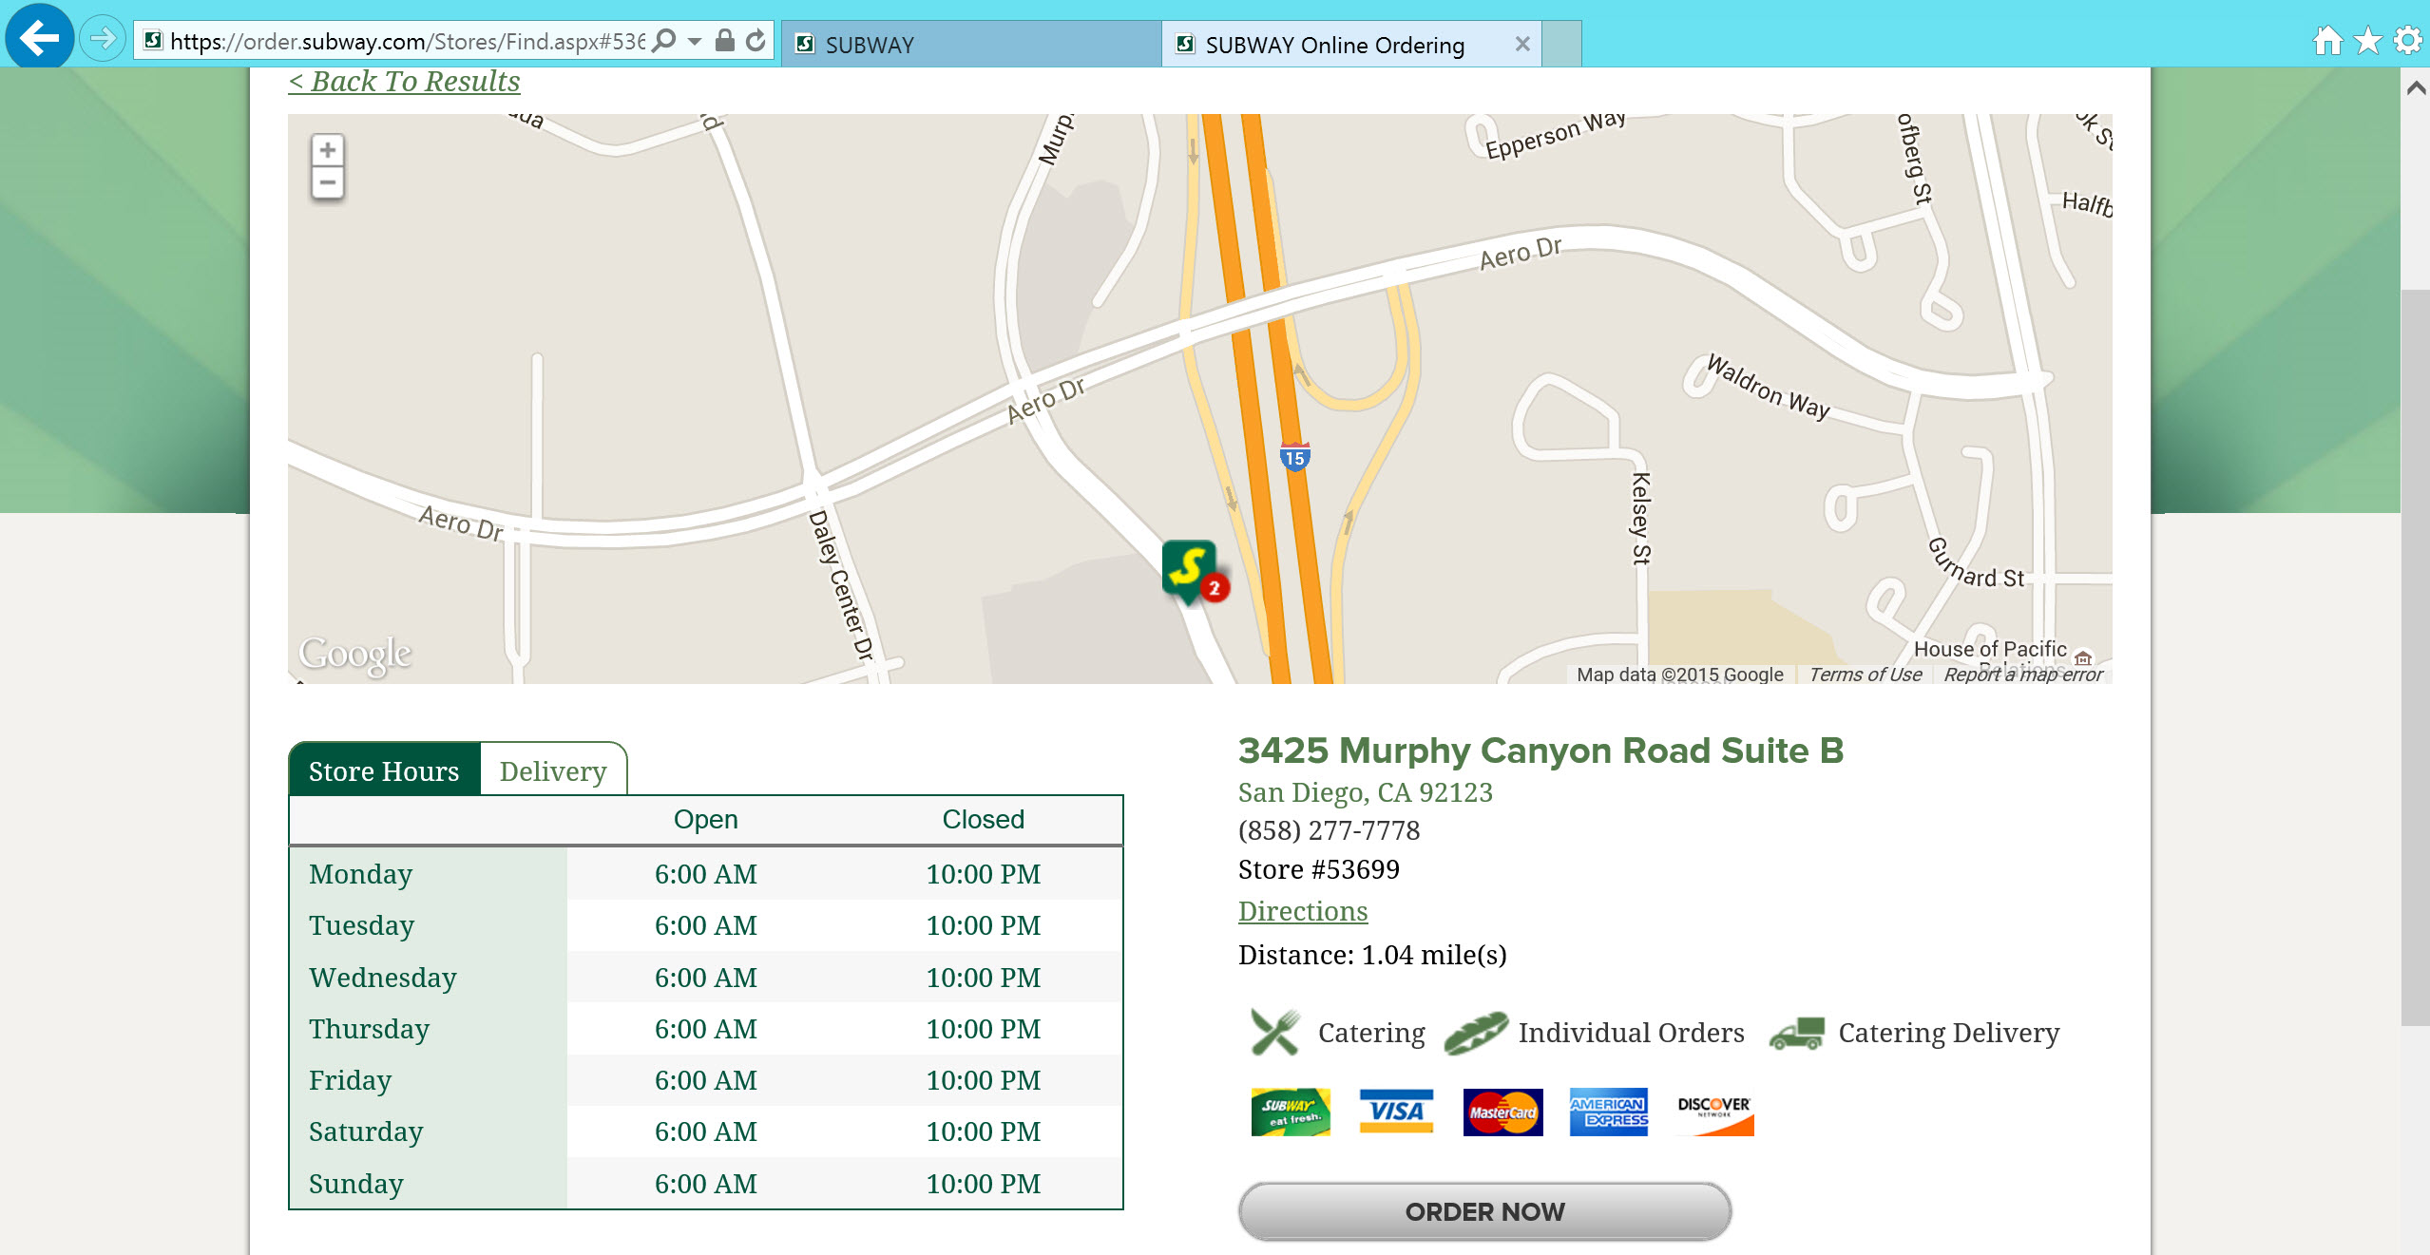
Notes:
This is SUBWAY’s website home page.
Subway is a fast food restaurant that prides itself on offering a healthy food menu.
Notice the link to Order Online. Yes it is small.
SUBWAY knows this service is not a main attraction and it hasn’t yet caught on. But tech-savvy customers will find it because it is a website menu item (pun).

Slide 7
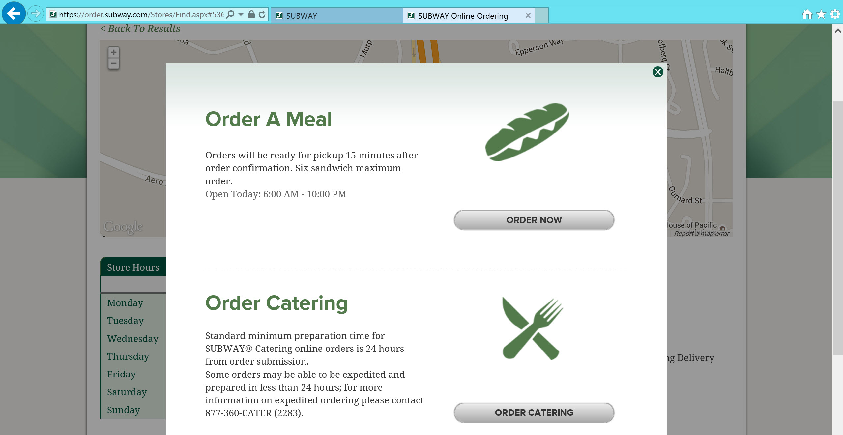
Notes:
This is SUBWAY’s website home page.
Subway is a fast food restaurant that prides itself on offering a healthy food menu.
Notice the link to Order Online. Yes it is small.
SUBWAY knows this service is not a main attraction and it hasn’t yet caught on. But tech-savvy customers will find it because it is a website menu item (pun).

Slide 8
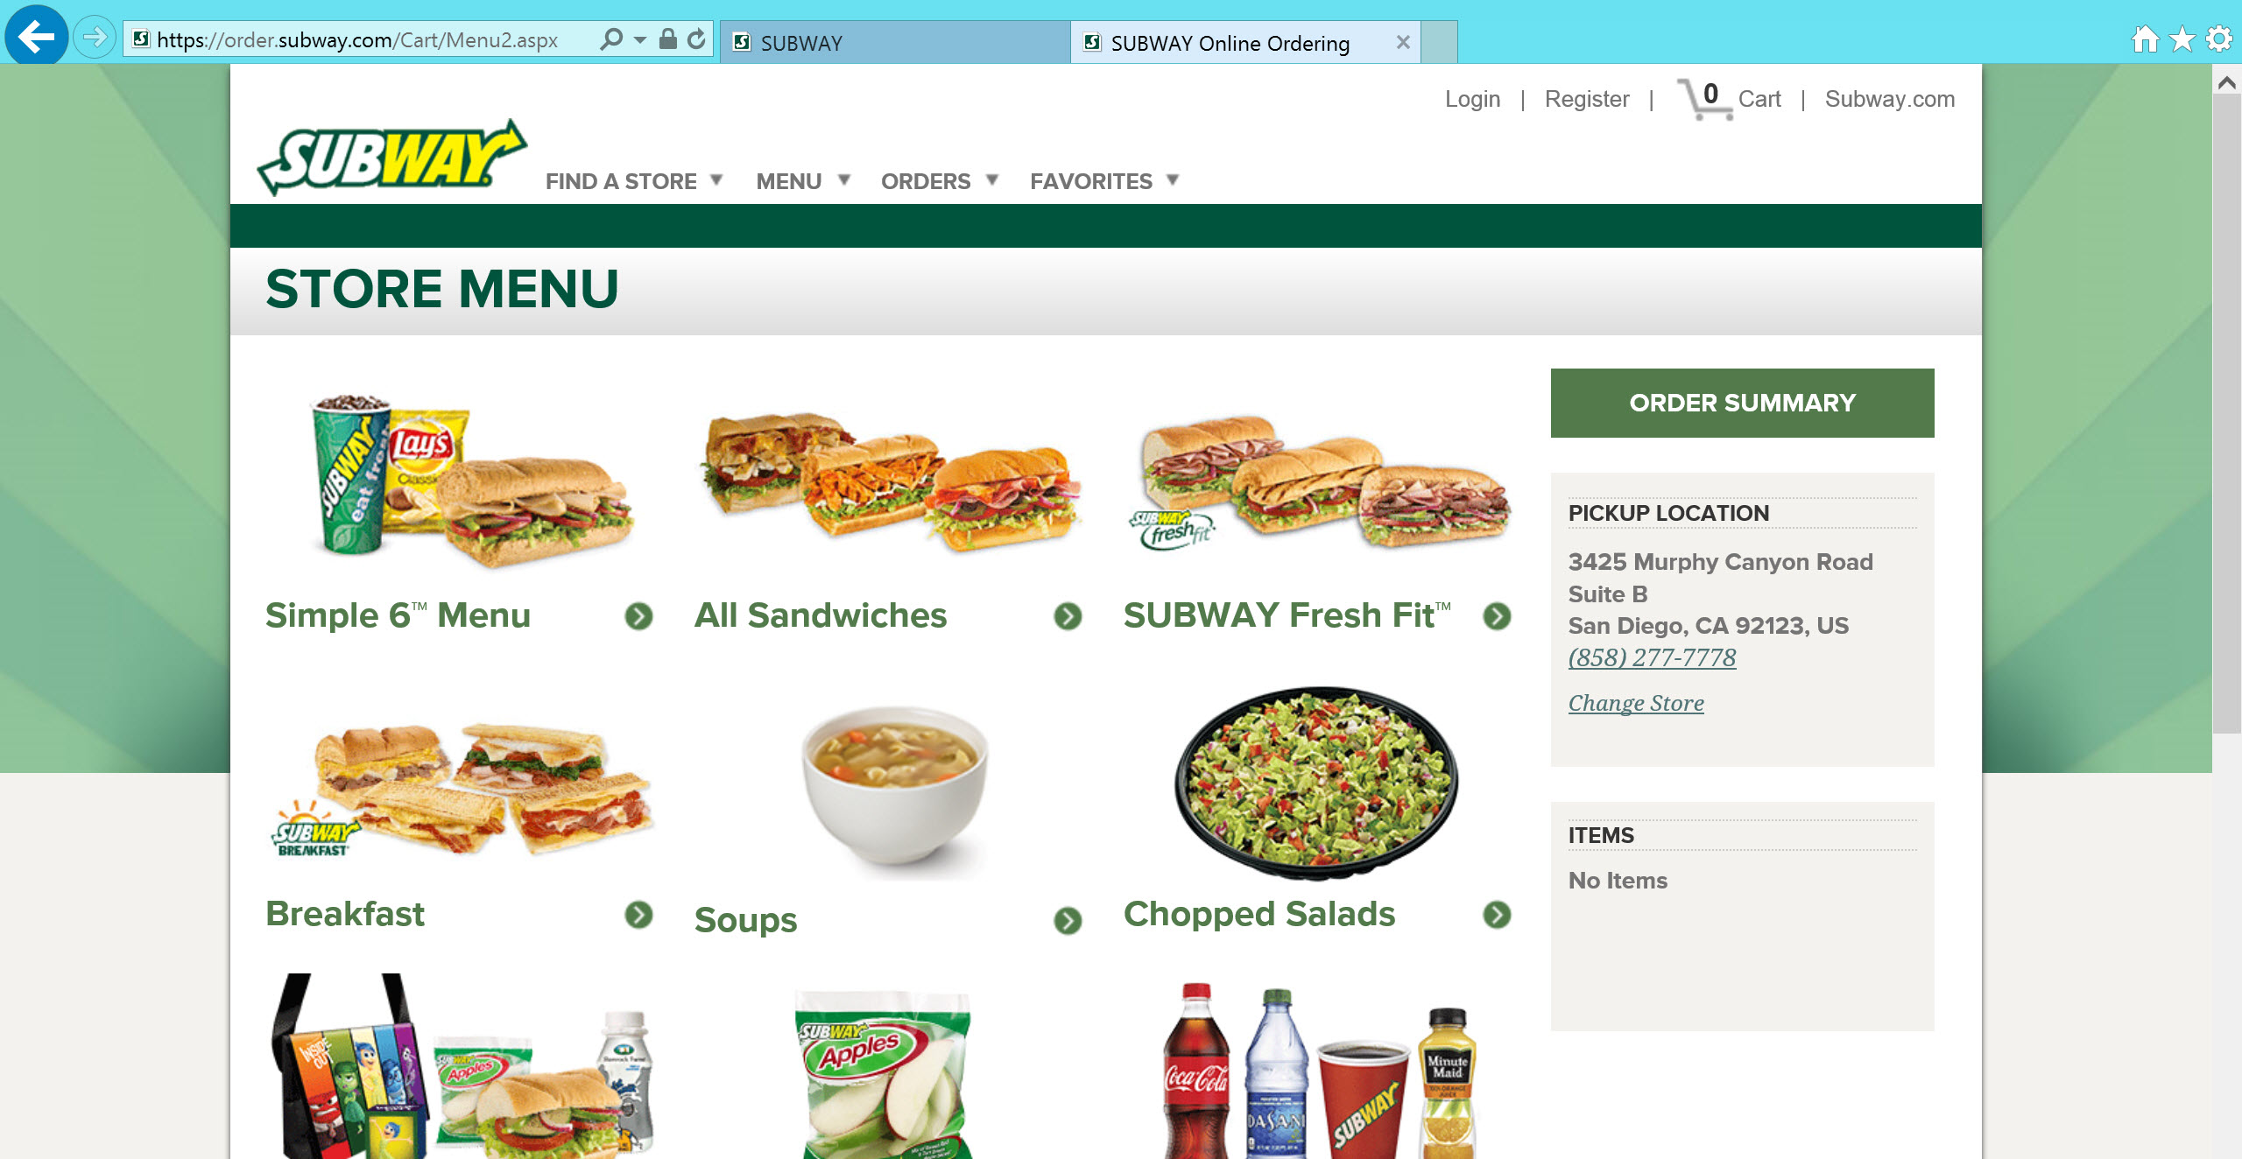
Notes:
This is SUBWAY’s website home page.
Subway is a fast food restaurant that prides itself on offering a healthy food menu.
Notice the link to Order Online. Yes it is small.
SUBWAY knows this service is not a main attraction and it hasn’t yet caught on. But tech-savvy customers will find it because it is a website menu item (pun).

Slide 9
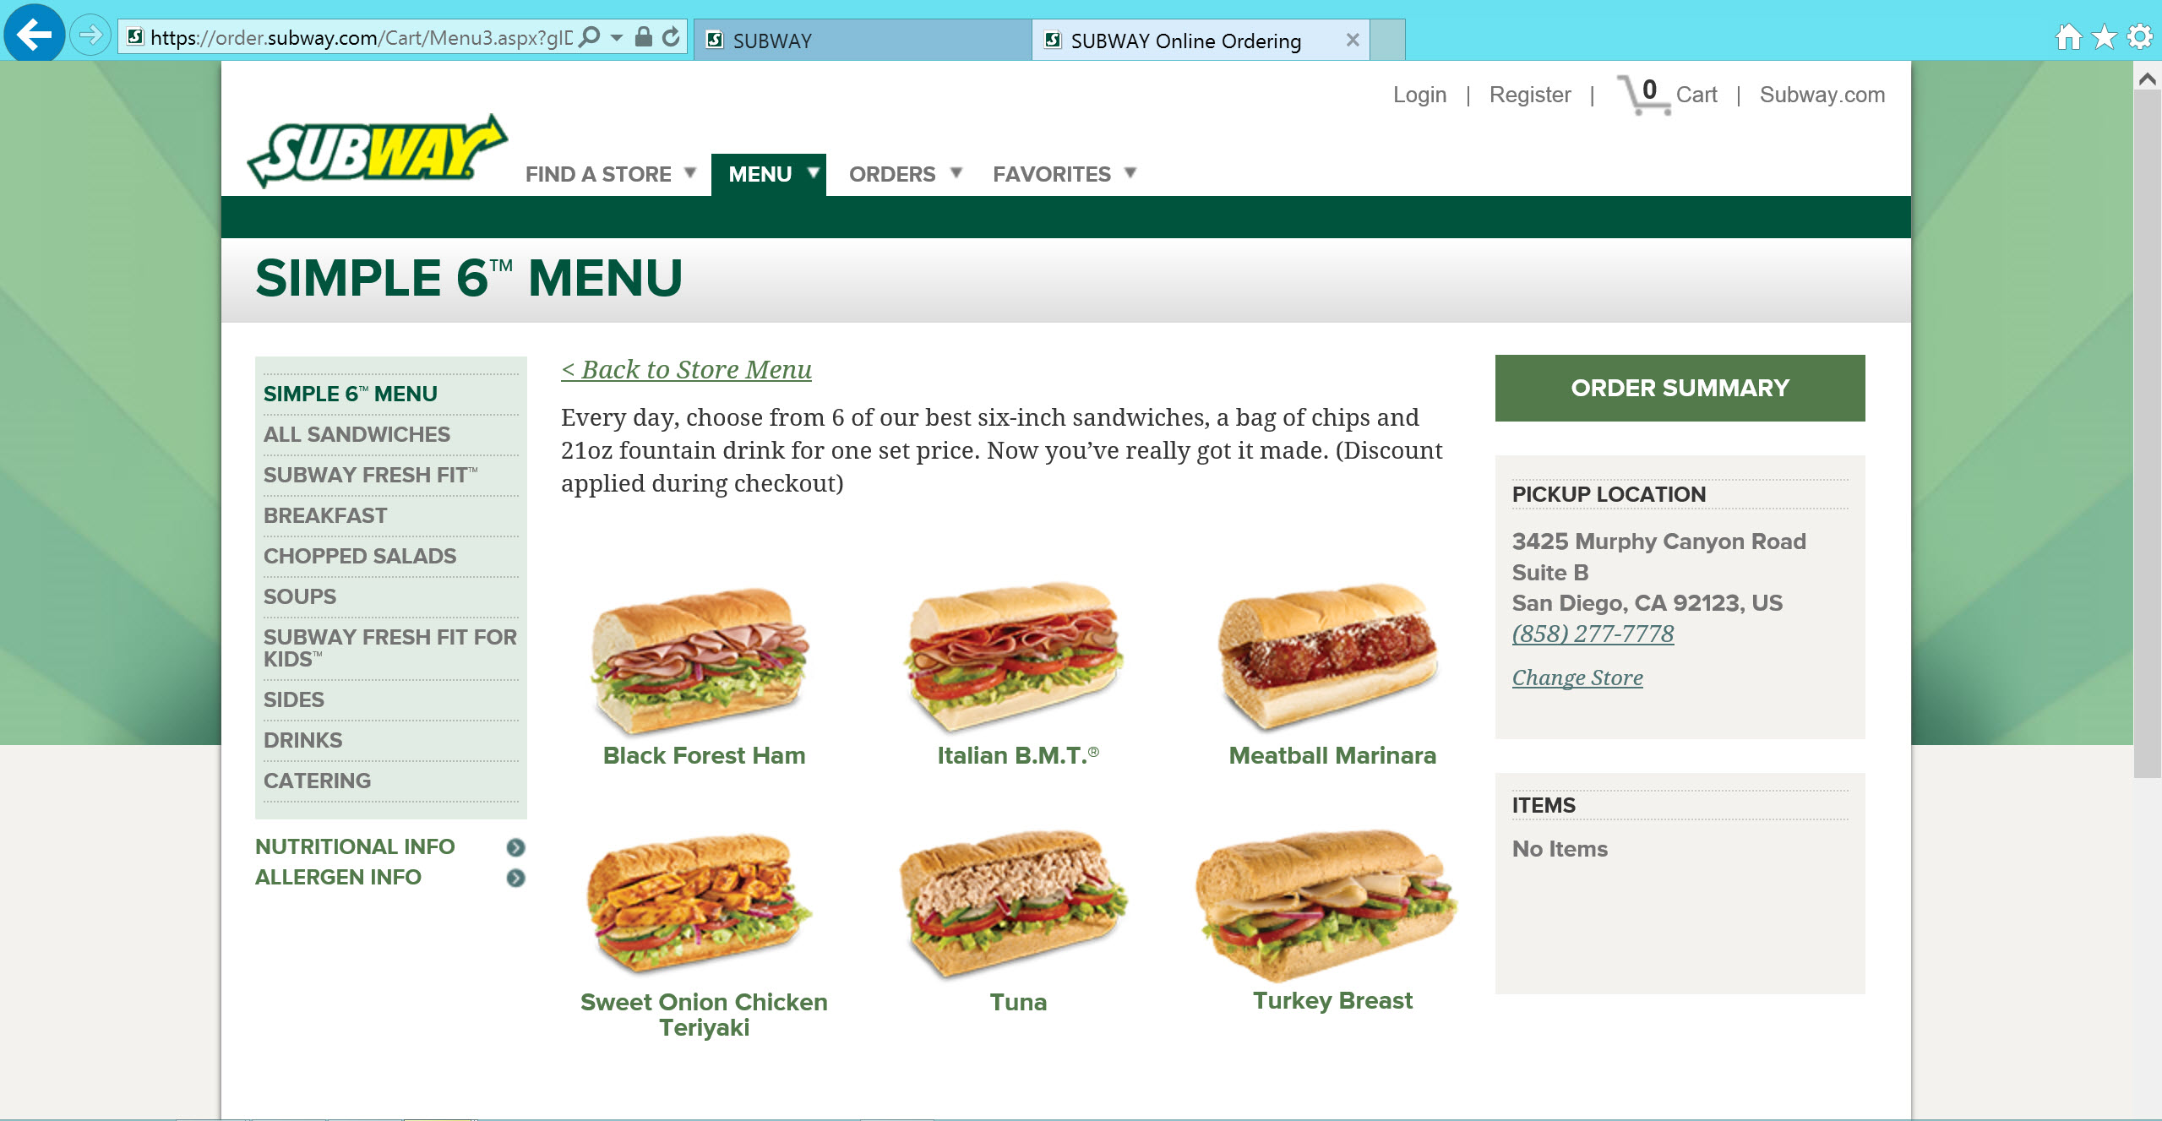
Notes:
This is SUBWAY’s website home page.
Subway is a fast food restaurant that prides itself on offering a healthy food menu.
Notice the link to Order Online. Yes it is small.
SUBWAY knows this service is not a main attraction and it hasn’t yet caught on. But tech-savvy customers will find it because it is a website menu item (pun).

Slide 10
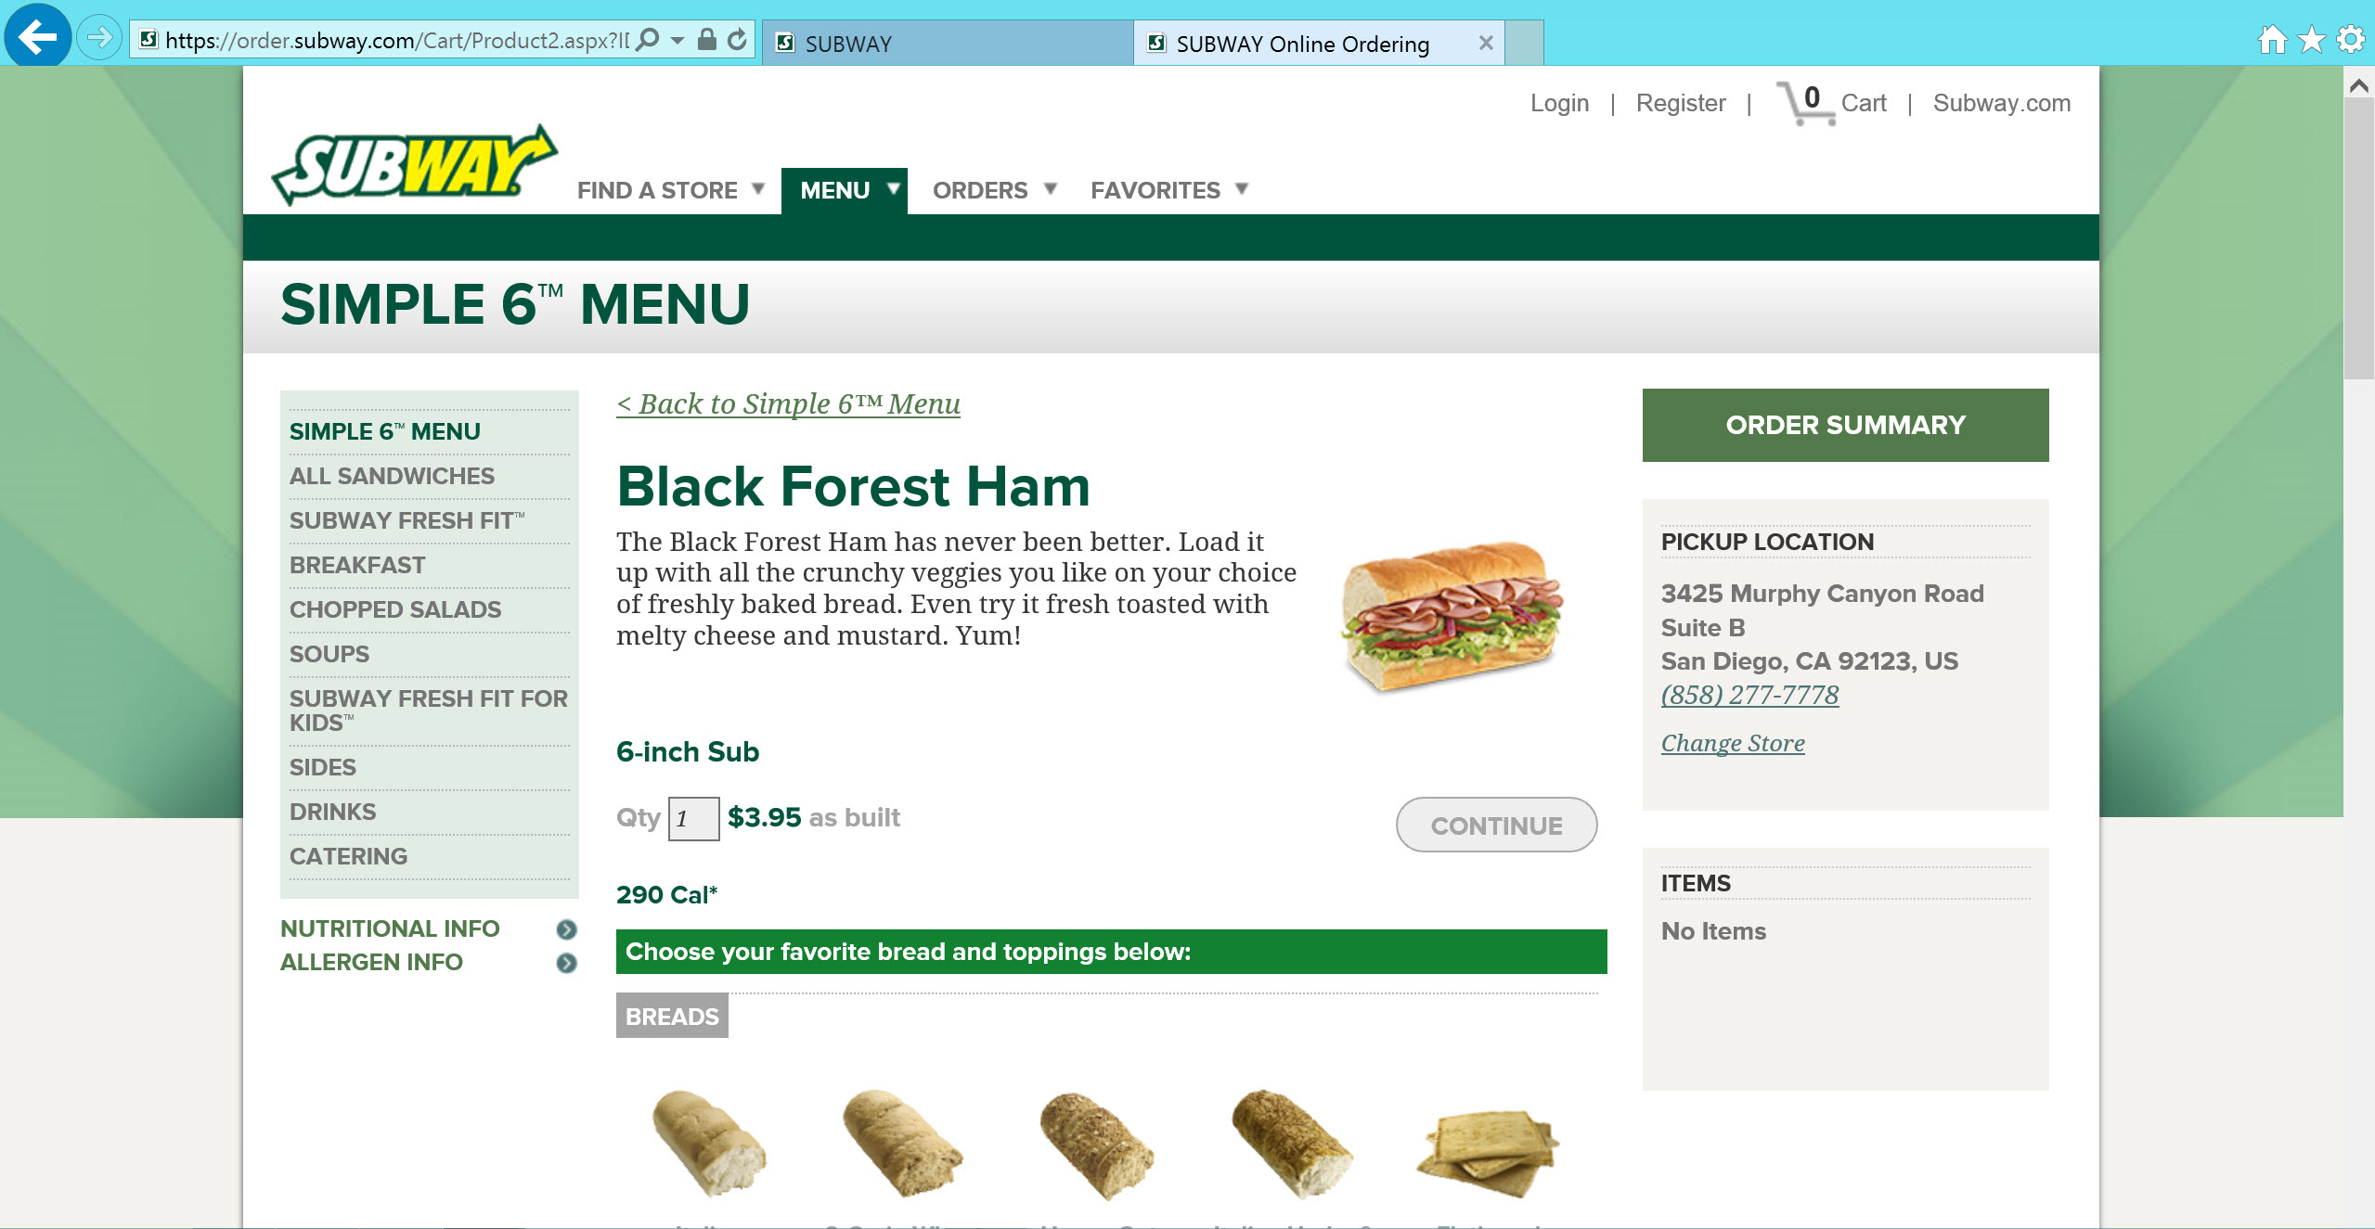
Notes:
This is SUBWAY’s website home page.
Subway is a fast food restaurant that prides itself on offering a healthy food menu.
Notice the link to Order Online. Yes it is small.
SUBWAY knows this service is not a main attraction and it hasn’t yet caught on. But tech-savvy customers will find it because it is a website menu item (pun).

Slide 11
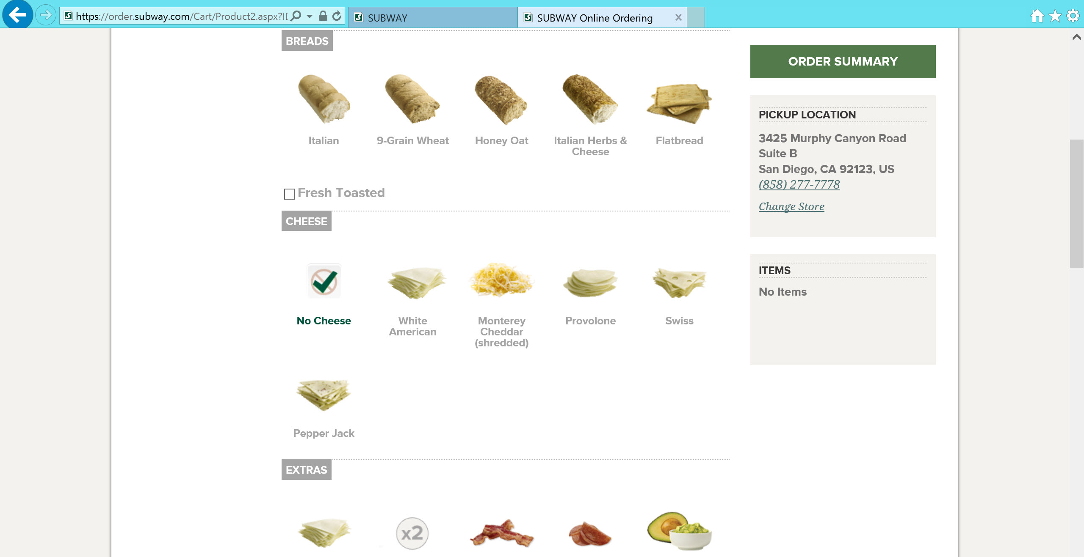
Notes:
This is SUBWAY’s website home page.
Subway is a fast food restaurant that prides itself on offering a healthy food menu.
Notice the link to Order Online. Yes it is small.
SUBWAY knows this service is not a main attraction and it hasn’t yet caught on. But tech-savvy customers will find it because it is a website menu item (pun).

Slide 12
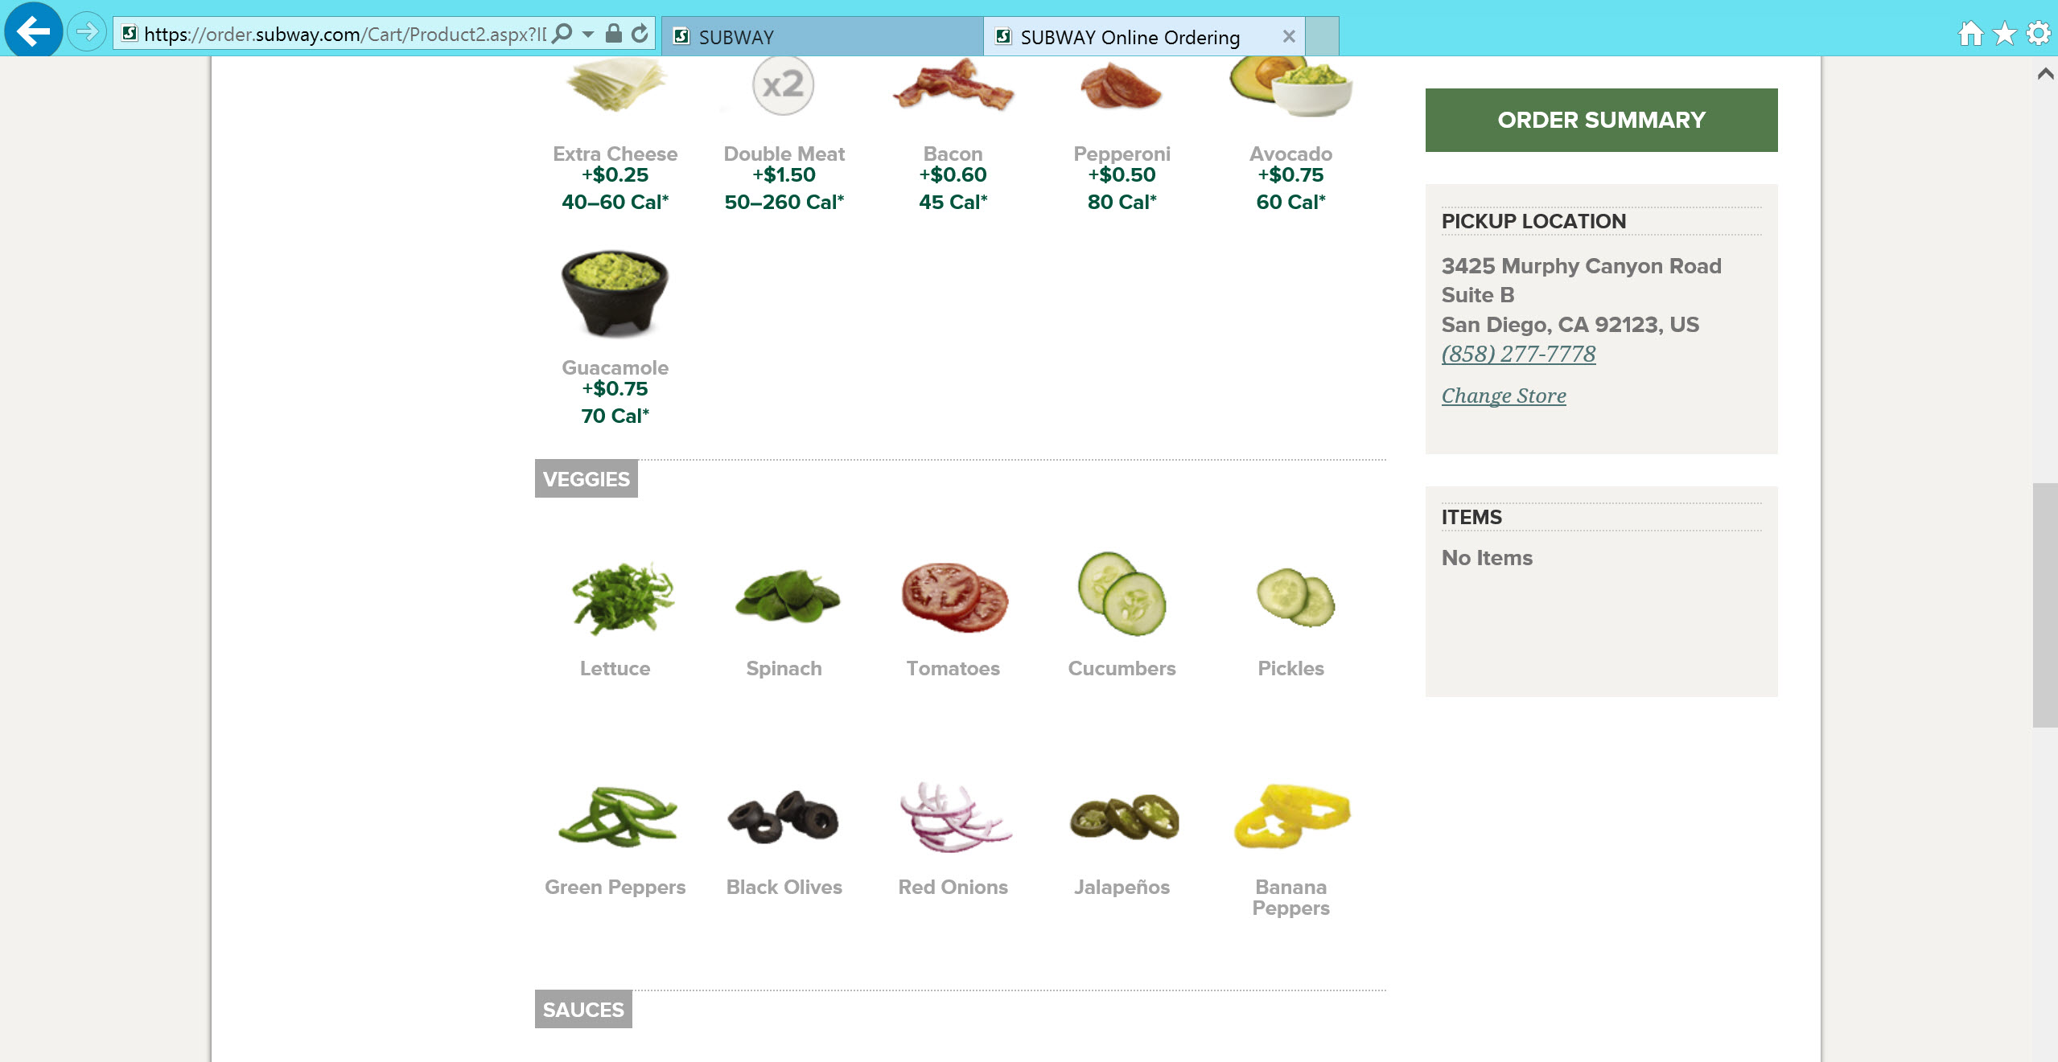
Notes:
This is SUBWAY’s website home page.
Subway is a fast food restaurant that prides itself on offering a healthy food menu.
Notice the link to Order Online. Yes it is small.
SUBWAY knows this service is not a main attraction and it hasn’t yet caught on. But tech-savvy customers will find it because it is a website menu item (pun).

Slide 13
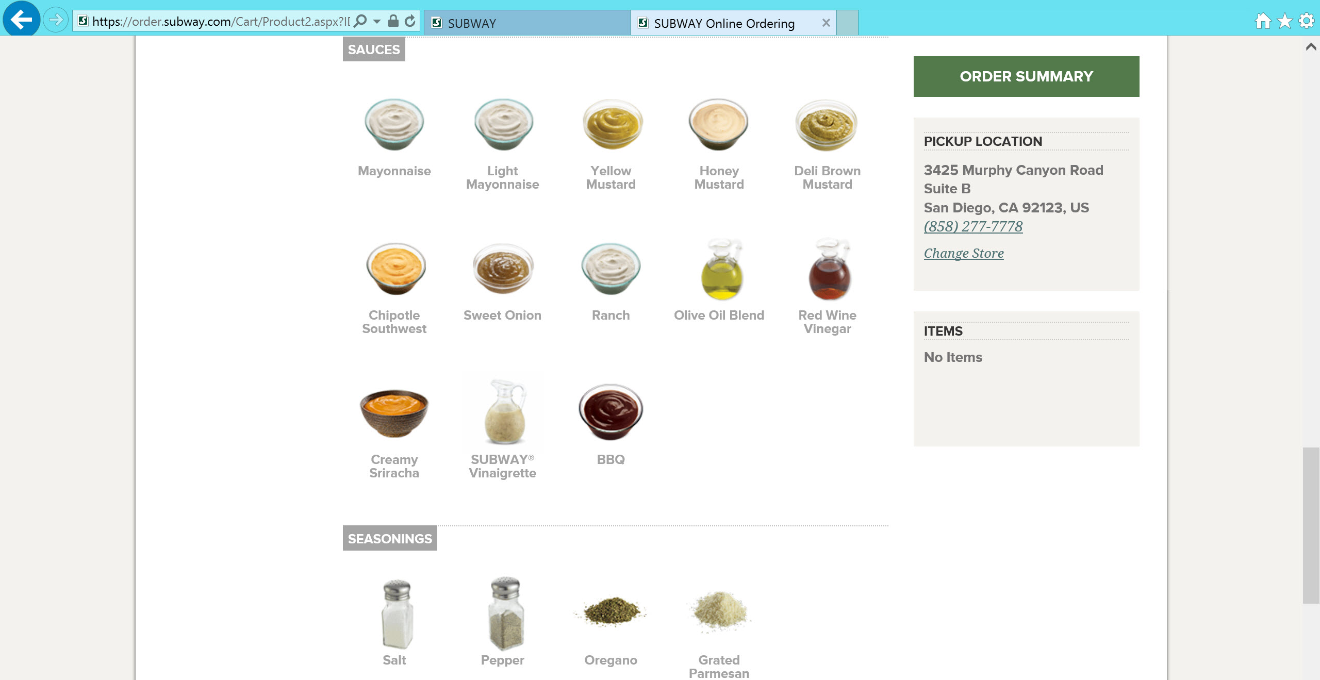
Notes:
This is SUBWAY’s website home page.
Subway is a fast food restaurant that prides itself on offering a healthy food menu.
Notice the link to Order Online. Yes it is small.
SUBWAY knows this service is not a main attraction and it hasn’t yet caught on. But tech-savvy customers will find it because it is a website menu item (pun).

Slide 14
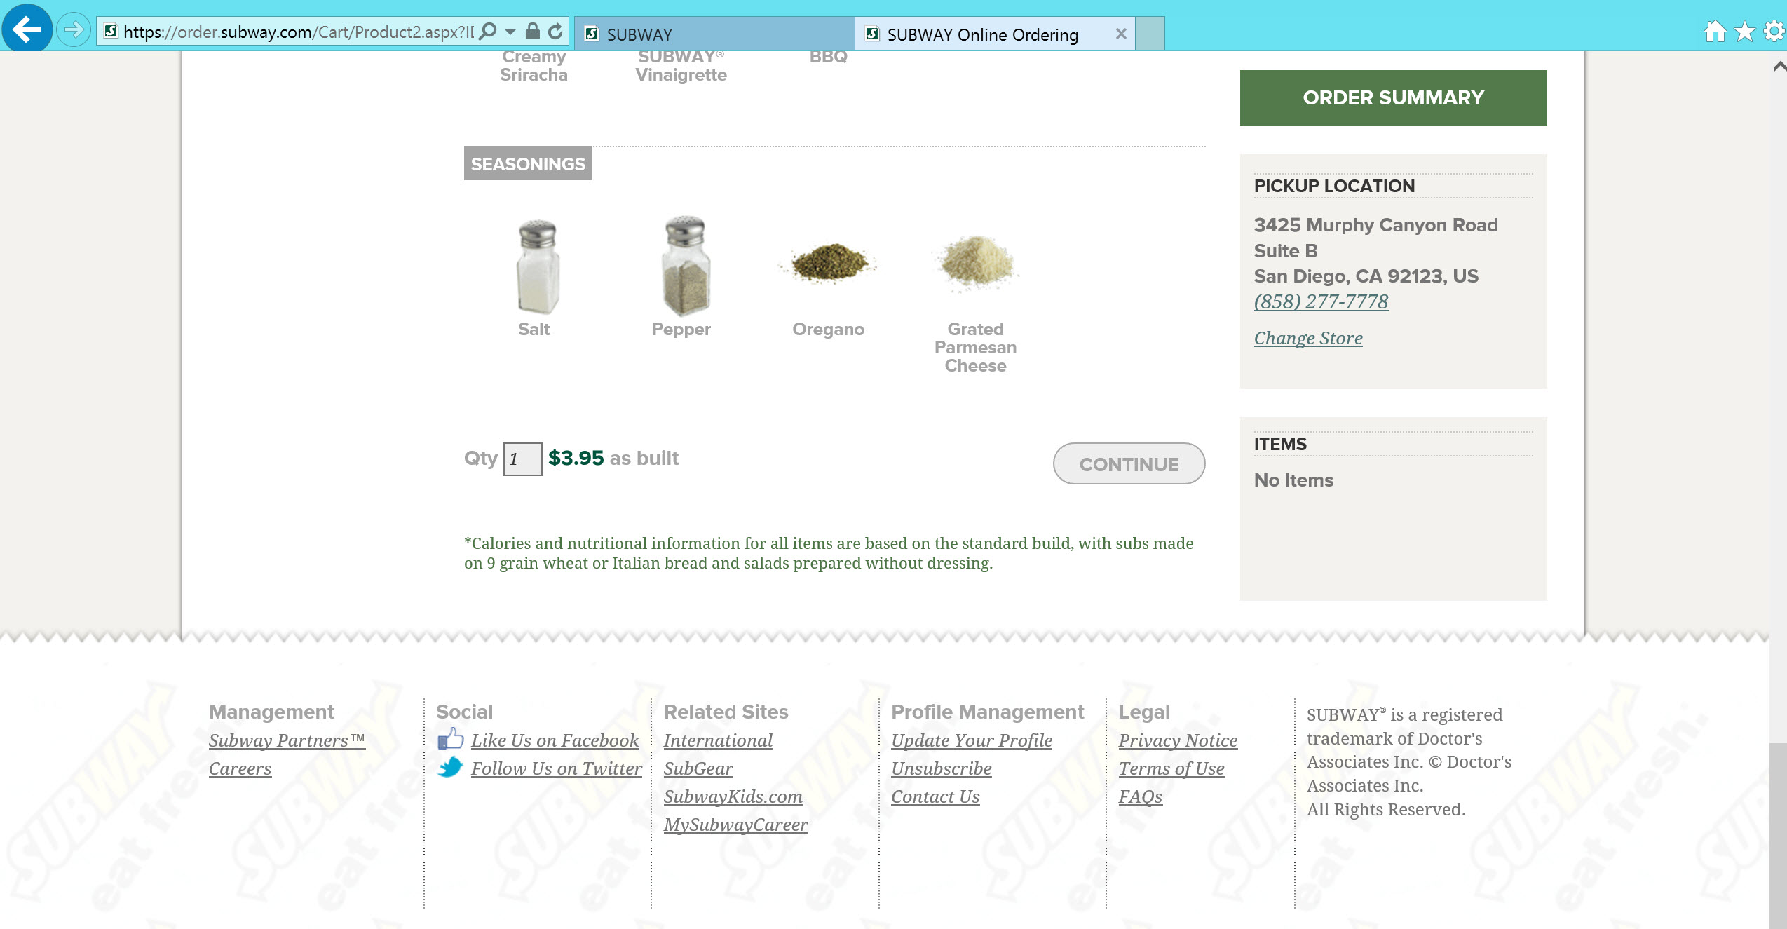
Notes:
This is SUBWAY’s website home page.
Subway is a fast food restaurant that prides itself on offering a healthy food menu.
Notice the link to Order Online. Yes it is small.
SUBWAY knows this service is not a main attraction and it hasn’t yet caught on. But tech-savvy customers will find it because it is a website menu item (pun).

Slide 15
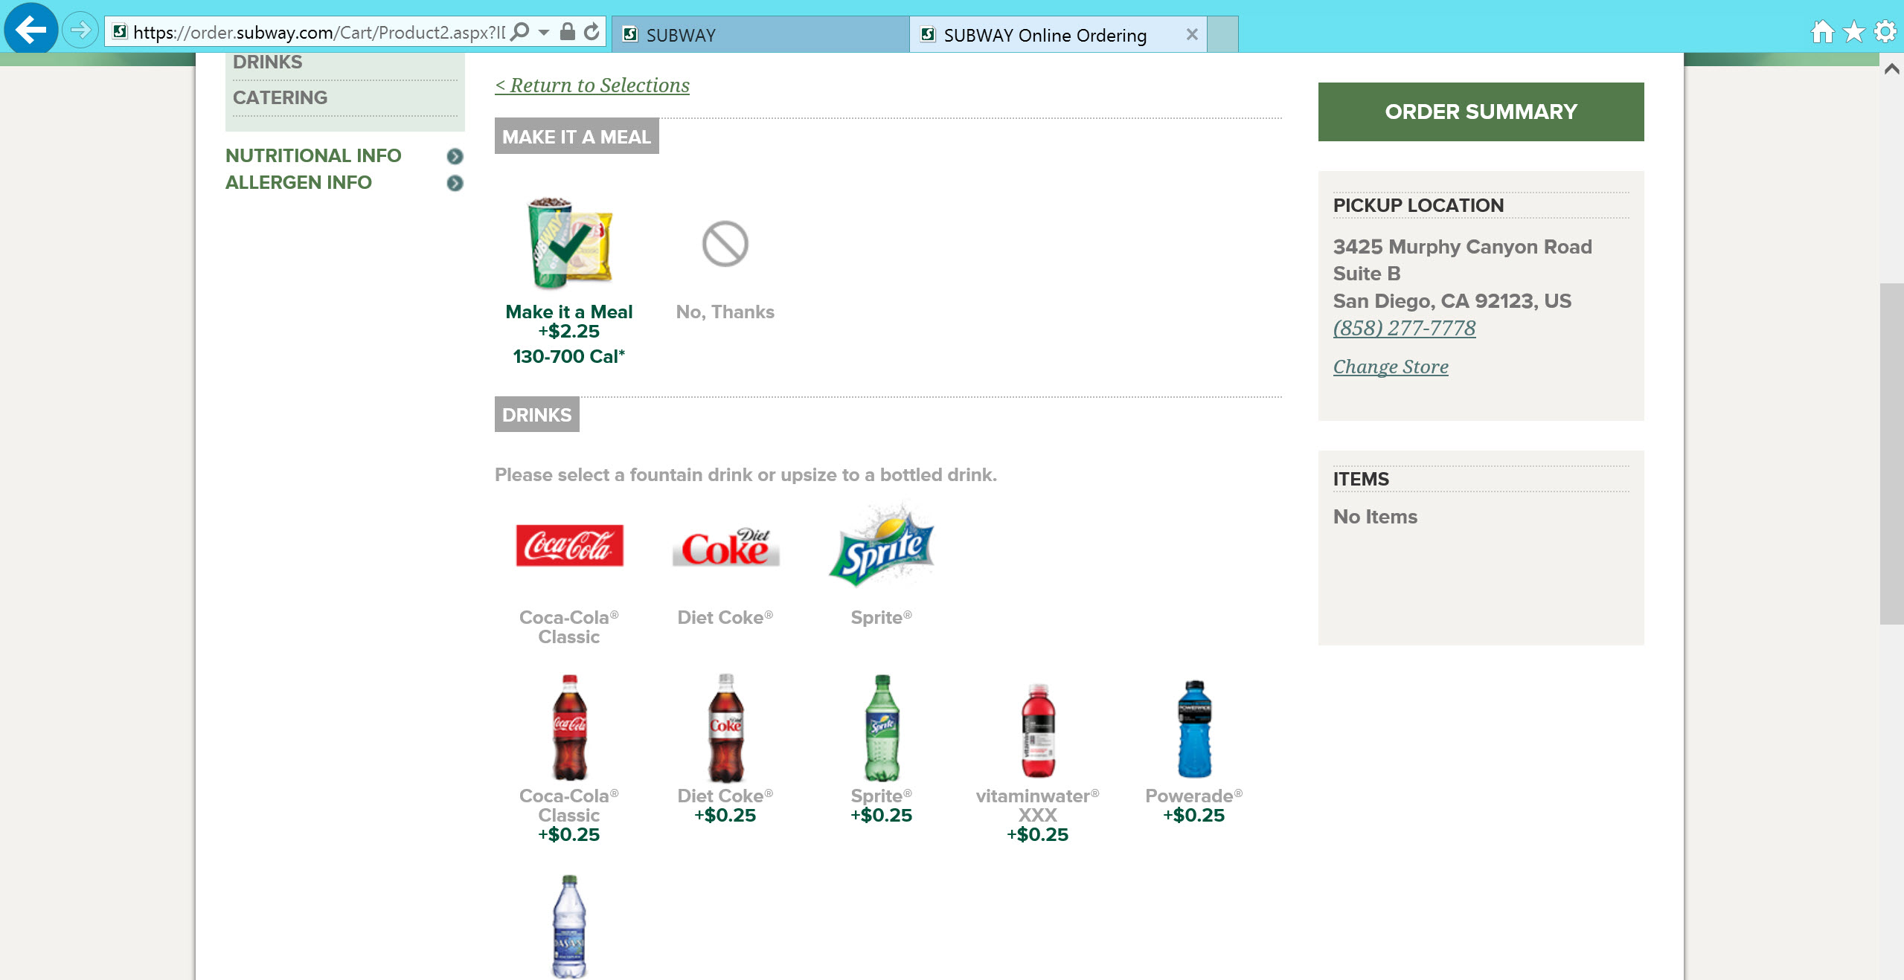
Notes:
This is SUBWAY’s website home page.
Subway is a fast food restaurant that prides itself on offering a healthy food menu.
Notice the link to Order Online. Yes it is small.
SUBWAY knows this service is not a main attraction and it hasn’t yet caught on. But tech-savvy customers will find it because it is a website menu item (pun).

Slide 16
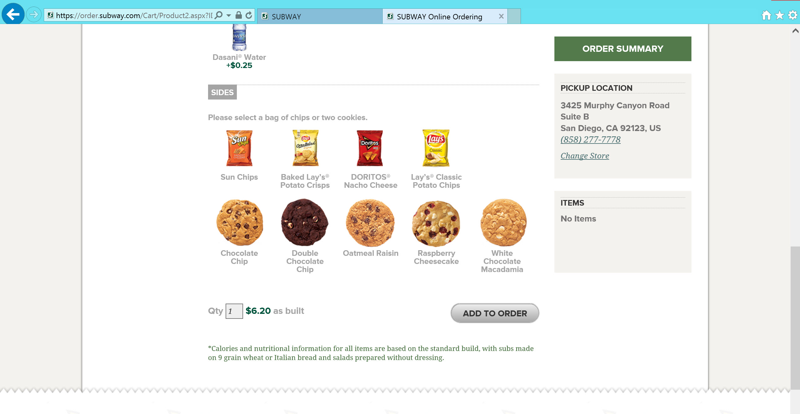
Notes:
This is SUBWAY’s website home page.
Subway is a fast food restaurant that prides itself on offering a healthy food menu.
Notice the link to Order Online. Yes it is small.
SUBWAY knows this service is not a main attraction and it hasn’t yet caught on. But tech-savvy customers will find it because it is a website menu item (pun).

Slide 17
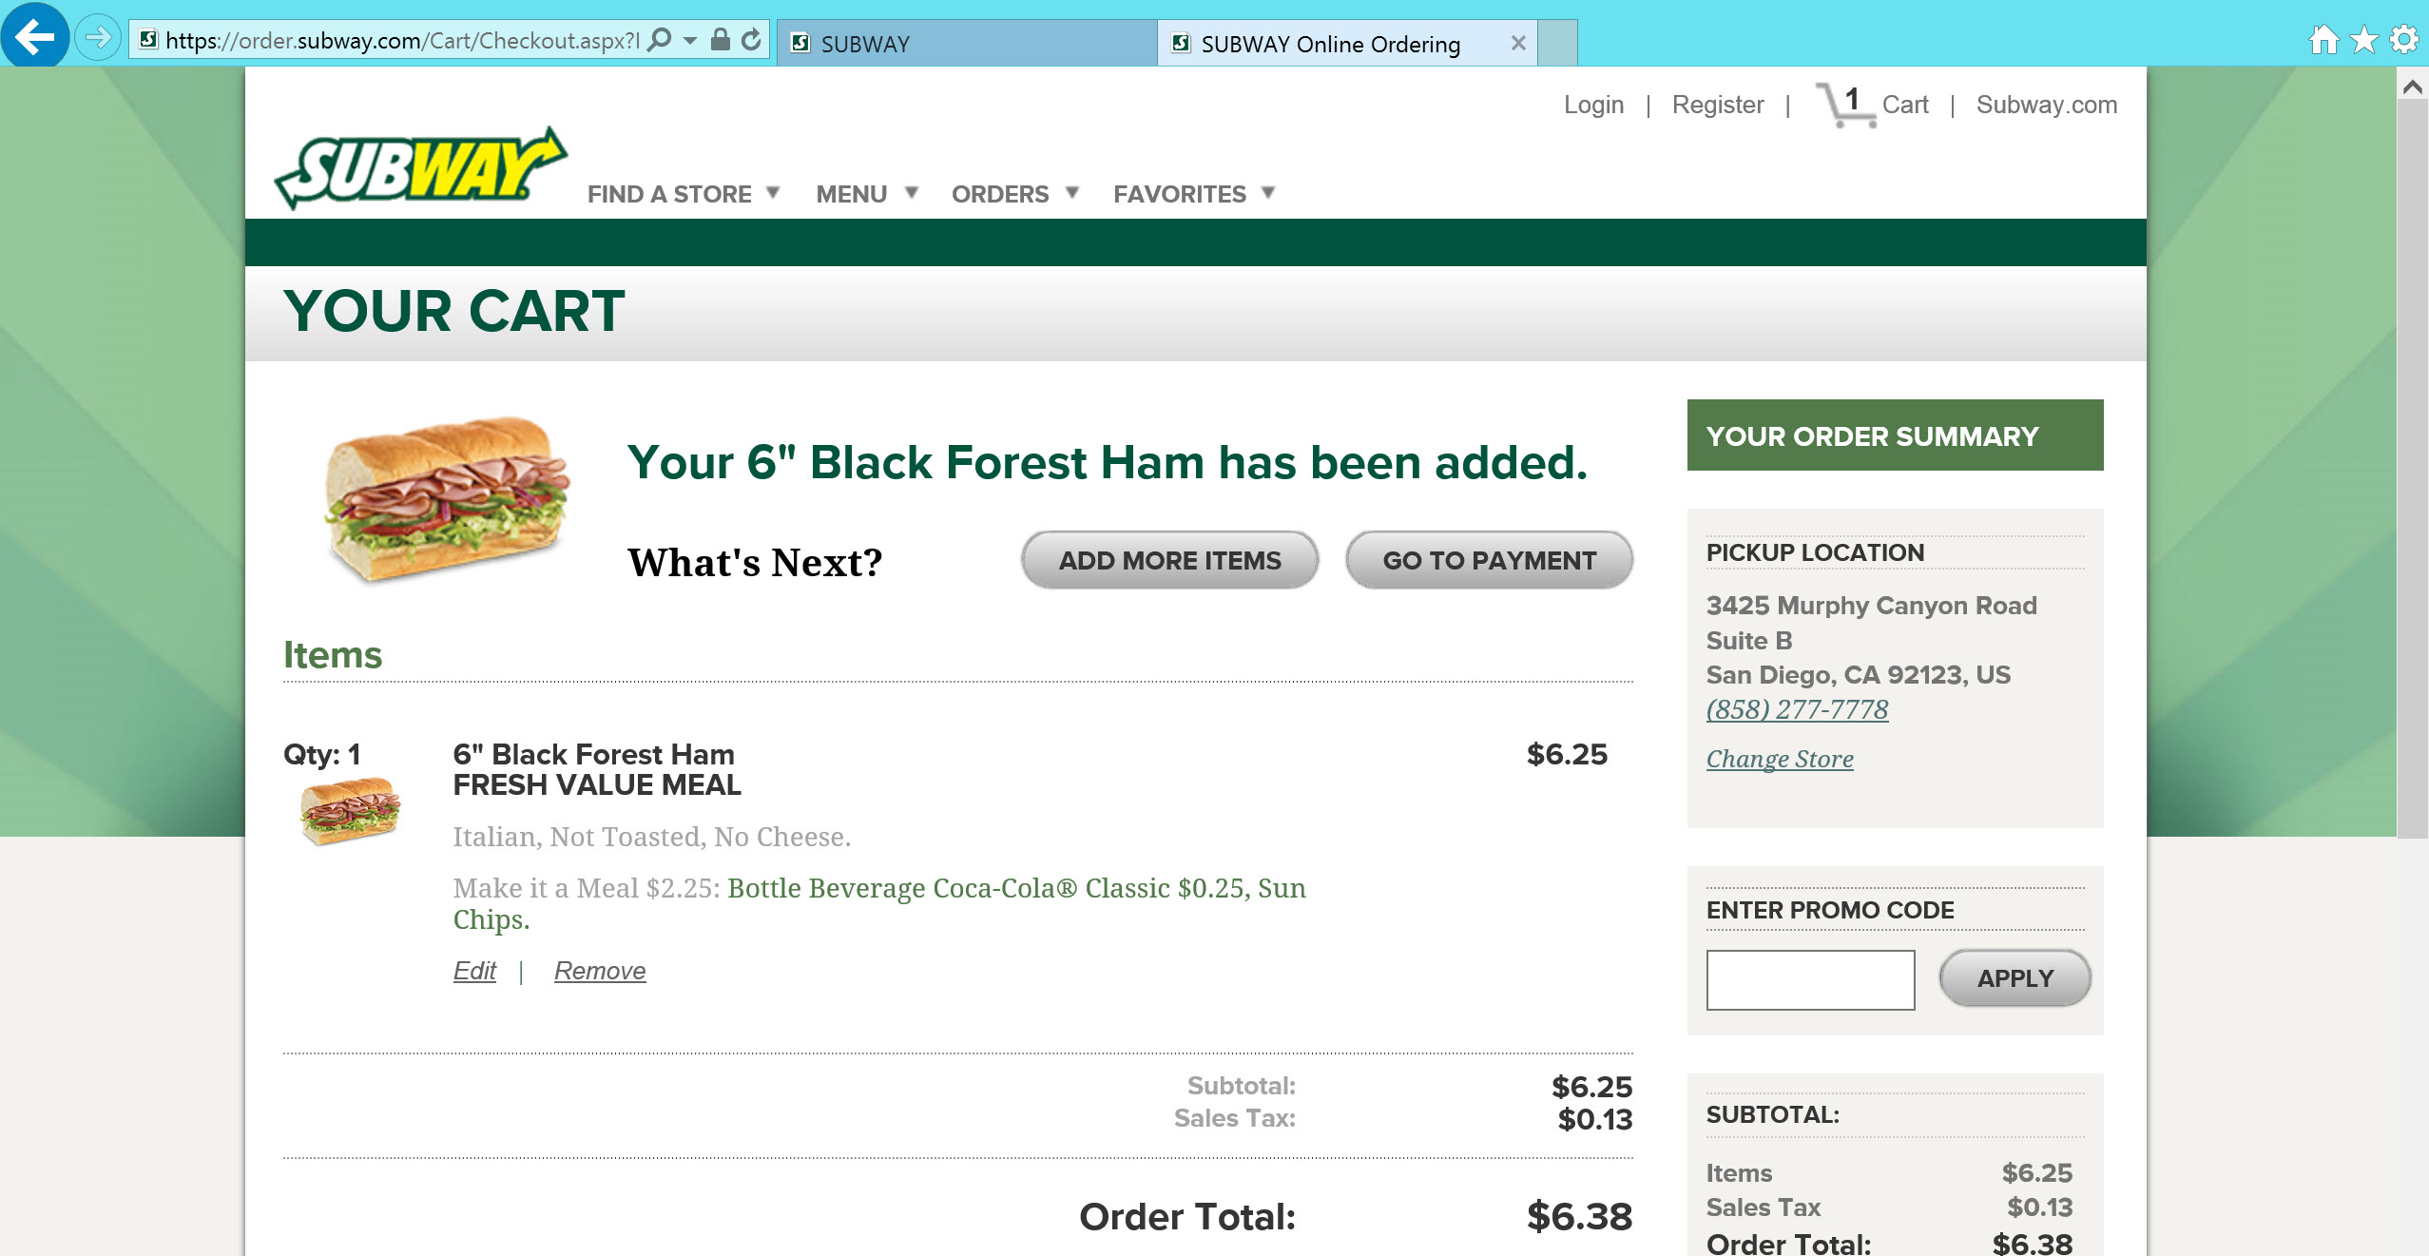
Notes:
This is SUBWAY’s website home page.
Subway is a fast food restaurant that prides itself on offering a healthy food menu.
Notice the link to Order Online. Yes it is small.
SUBWAY knows this service is not a main attraction and it hasn’t yet caught on. But tech-savvy customers will find it because it is a website menu item (pun).

Slide 18
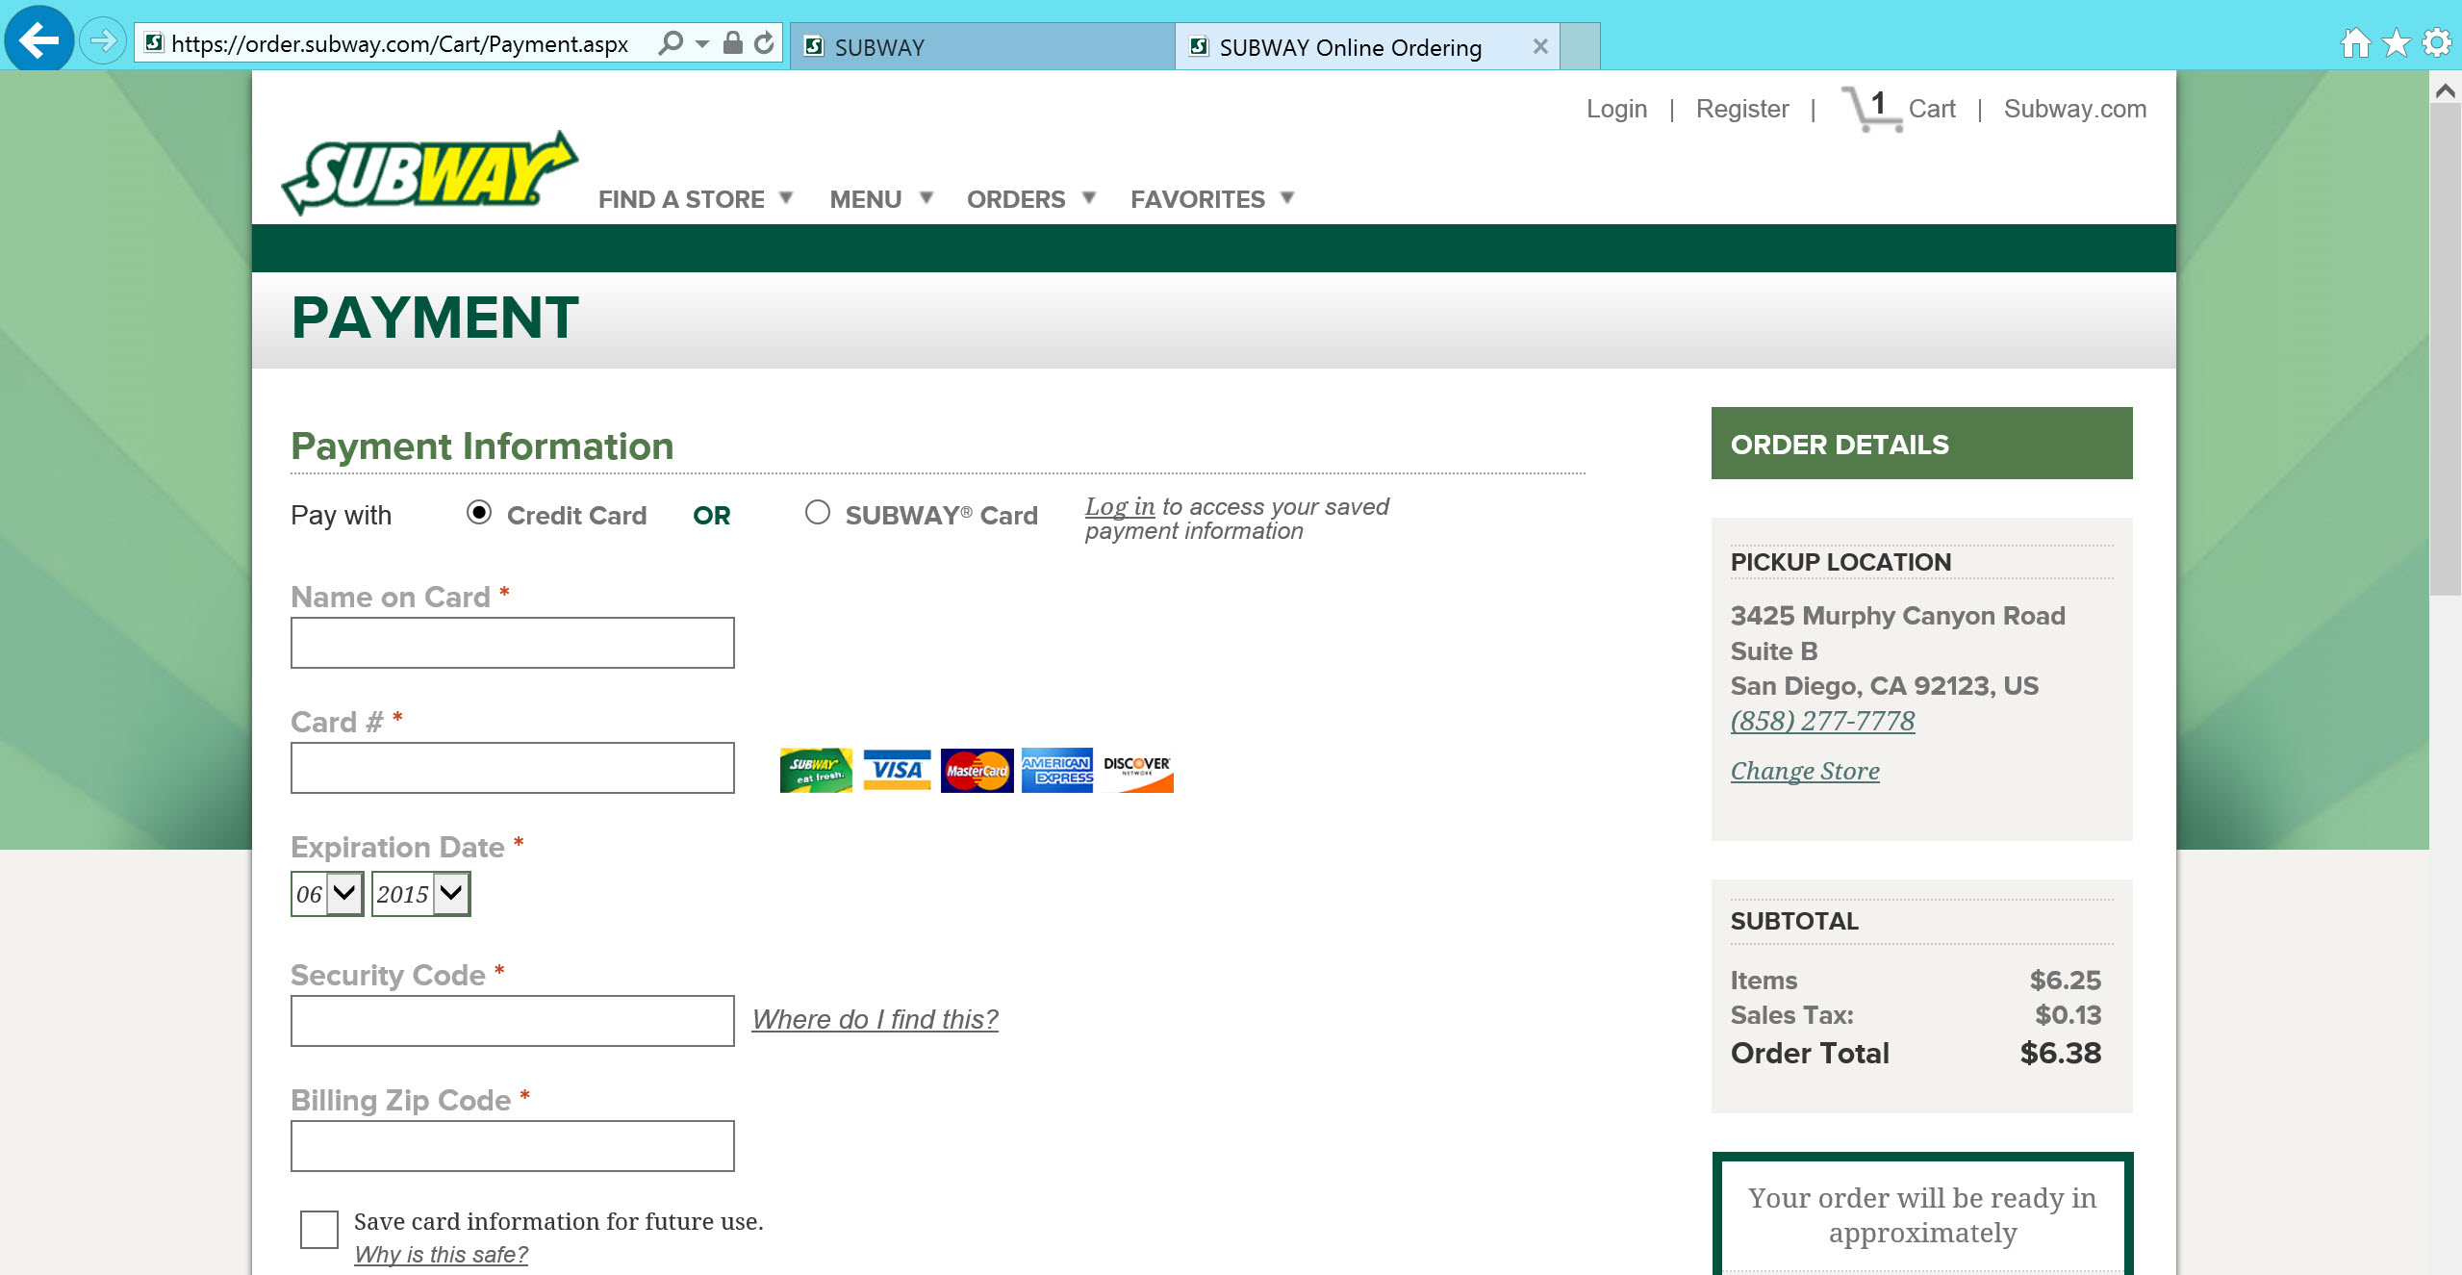
Notes:
This is SUBWAY’s website home page.
Subway is a fast food restaurant that prides itself on offering a healthy food menu.
Notice the link to Order Online. Yes it is small.
SUBWAY knows this service is not a main attraction and it hasn’t yet caught on. But tech-savvy customers will find it because it is a website menu item (pun).

Slide 19
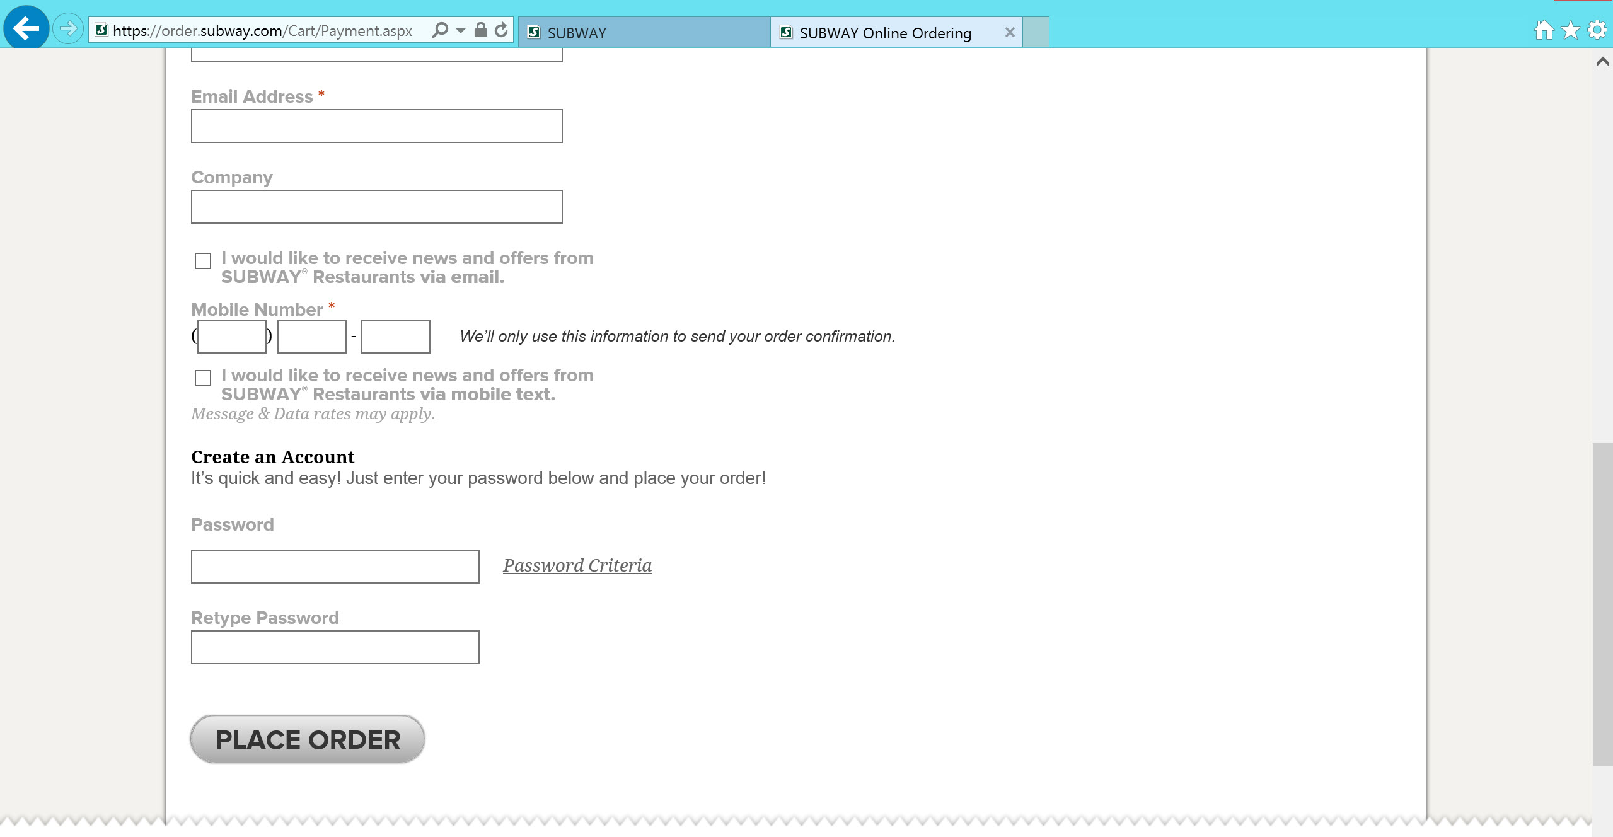
Notes:
This is SUBWAY’s website home page.
Subway is a fast food restaurant that prides itself on offering a healthy food menu.
Notice the link to Order Online. Yes it is small.
SUBWAY knows this service is not a main attraction and it hasn’t yet caught on. But tech-savvy customers will find it because it is a website menu item (pun).

Slide 20

“I’m going to SUBWAY do you want anything?”
“…YES!” “…YES!”
Notes:
This is SUBWAY’s website home page.
Subway is a fast food restaurant that prides itself on offering a healthy food menu.
Notice the link to Order Online. Yes it is small.
SUBWAY knows this service is not a main attraction and it hasn’t yet caught on. But tech-savvy customers will find it because it is a website menu item (pun).

Slide 21
Analytical Innovators
Customer Perspective of SUBWAY Online Ordering System
Measure what KPIs for the customer perspective?
Does the online food ordering affect the regular customer wait times? Track the KPI: volume (sales).
2. Do customers accept and use the online food ordering system? Compare to regular orders with the KPI: switched customers and KPI: new customers using it.
3.
Notes:
We are a business consulting company named “Analytical Innovators.”
Subway came to us for expertise in the development of a performance management system to support decisions to resolve difficulties and pursue opportunities. The challenge is to integrate Subway’s new customer online ordering service into their existing restaurant operations.
We developed a balanced scorecard (BSC) that views the Subway Corporation from four perspectives – customer, financial, internal business processes, learning and growth.
The BSC will be used to develop objectives relative to each perspective. KPIs are determined to answer strategic questions for solutions to problems and opportunities.

Slide 22
BUSINESS INTELLIGENCE
Building Back-End Database and System Yuxuan Guan
The Requirements – Why Online Ordering ?
Boost order performance during peak hours
Promotions/Social Media/Big Data
System must fits Subway’s fast philosophy
Low cost

Slide 23
BUSINESS INTELLIGENCE
Building Back-End Database and System Yuxuan Guan
The Requirements – Making Decisions
Simple Data Structure
Apply to open source DMS
Easy to manage
Minimum impact to the existing system

Slide 24
BUSINESS INTELLIGENCE
Building Back-End Database and System Yuxuan Guan
The Requirements – Making Decisions
Star System topology
Each store gets its own system
Same system will be deployed across the country
Easy to maintain
Each terminal is a data source

Slide 25
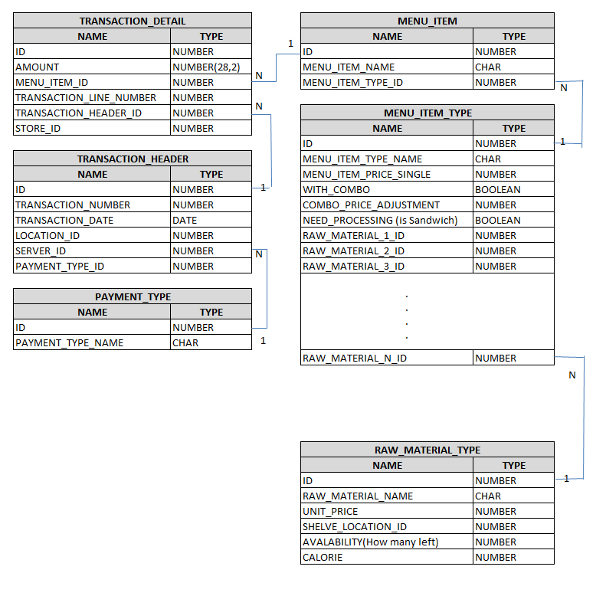
BUSINESS INTELLIGENCE
Building Back-End Database and System Yuxuan Guan
Database - ERD

Slide 26
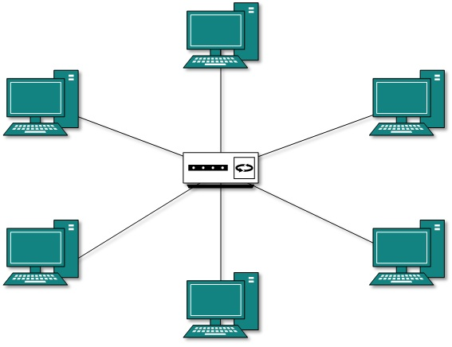
BUSINESS INTELLIGENCE
Building Back-End Database and System Yuxuan Guan
System Topology

Slide 27
BUSINESS INTELLIGENCE
Financial Gabriel
Costs
32% of each dollar goes to cost of food and beverages.
29% is salaries and wages
8% to restaurant occupancy
6% profits before taxes

Slide 28
BUSINESS INTELLIGENCE
Financial Gabriel
how do we rank the popularity of menu items?
Tracking repeat orders
how do we determine the best profit margins for promotions?
Measuring food profit margins of popular items
can we increase volume at existing restaurant locations?
Online ordering stations can be setup in out of sight spaces in current stores

Slide 29
BUSINESS INTELLIGENCE
Financial Gabriel
Opening new locations
Measure volume of sales by geographical area
volume (sales) by market segment

Slide 30
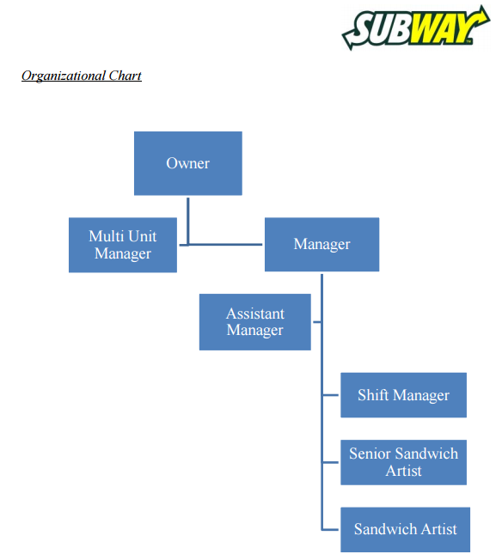
BUSINESS INTELLIGENCE
Operations research and Management Sean
Franchise Business
-- Doctor’s Associate Inc.

Slide 31
BUSINESS INTELLIGENCE
Operations research and Management Sean
Website Management
Database Maintenance
User Experience

Slide 32
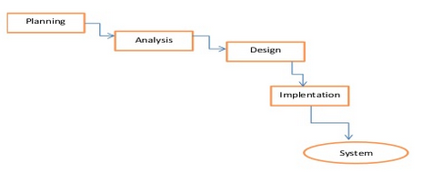
BUSINESS INTELLIGENCE
Operations research and Management Sean
System Development Life Cycle (SDLC)

Slide 33
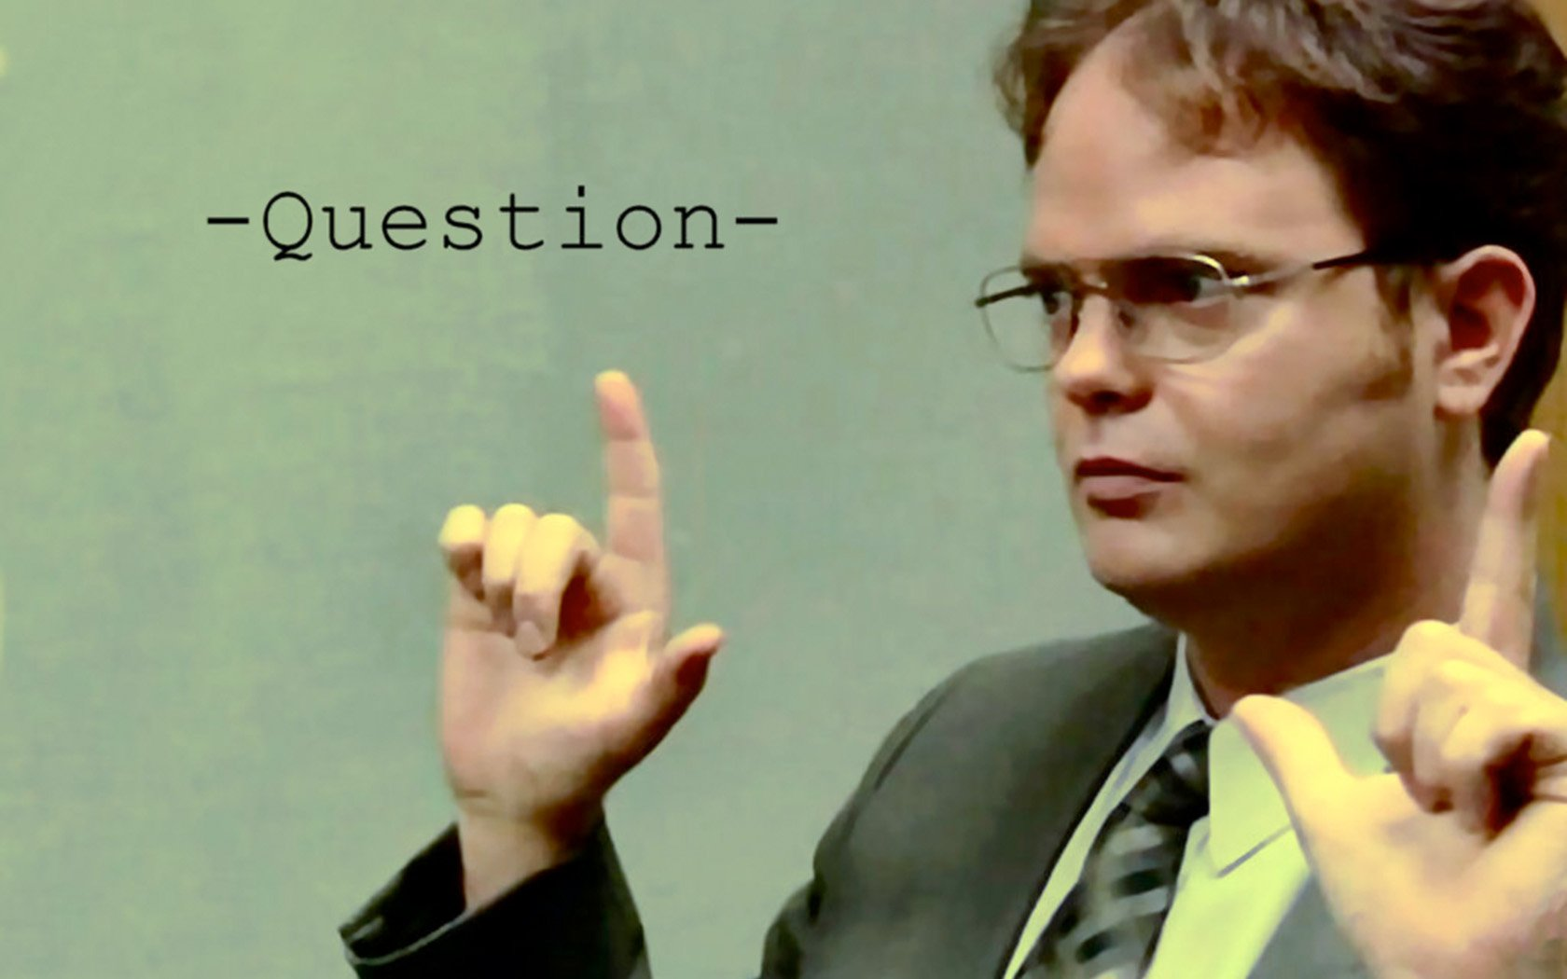
“I’m going to SUBWAY do you want anything?”

